Slide 1

KEY MARKET SIGNALS FOR THE DAIRY INDUSTRY
(A presentation to the online General Meeting of SAMPRO by the CEO of SAMPRO
based on research reports of SAMPRO) on
20 November 2025
This presentation is available to any interested party and copies can be obtained from the Office of SAMPRO – telephone number 012 991 4164.
Enquiries regarding the content of the presentation should be directed to Alwyn P Kraamwinkel, telephone number 012 991 4164 or alwyn@sampro.co.za
South African Milk Processors’ Organisation
The voluntary organisation of milk processors for the promotion of the development of the secondary dairy industry to the benefit of the dairy industry, the consumer and the South African society.

Slide 2
Key Market signals for the Dairy Industry are about:
CONDITIONS IN THE WORLD
THE INTERNATIONAL MARKETS FOR DAIRY PRODUCTS
THE UNPROCESSED MILK MARKETS IN MAJOR DAIRY COUNTRIES
CONDITIONS IN SOUTH AFRICA
THE UNPROCESSED MILK MARKET IN SOUTH AFRICA
THE SOUTH AFRICAN MARKETS FOR DAIRY PRODUCTS

Slide 3
CONDITIONS IN THE WORLD
In 2025, very high uncertainty remained a reality due to:
  Continuation of military and other conflicts; and
  Actions and the unpredictability of future actions by the USA, in respect of especially:
    - Import tariffs;
    Military conflicts;
    Diplomatic relations;
    Multi lateral organisations; and
    Domestic affairs of other countries.

Slide 4
CONDITIONS IN THE WORLD (Continue)
Even if the conflicts stop immediately, negative consequences will, to a large extent, be a reality in the coming years.
Economic growth is undermined by the very high uncertainty.

Slide 5
ECONOMIC GROWTH RATES AND EXPECTED GROWTH RATES IN SELECTED COUNTRIES
 | 2023 | 2024 | 2025 | 2026
Region / country | Actual |  | Forecast
World | 3.5 | 3.3 | 3.2 | 3.1
Advanced economies | 1.7 | 1.8 | 1.6 | 1.6
United States | 2.9 | 2.8 | 2.0 | 2.1
Euro area | 0.4 | 0.9 | 1.2 | 1.1
United Kingdom | 0.4 | 1.1 | 1.3 | 1.3
Japan | 1.2 | 0.1 | 1.1 | 0.6
Emerging and developing countries | 4.7 | 4.3 | 4.2 | 4.0
Brazil | 3.2 | 3.4 | 2.4 | 1.9
Russia | 4.1 | 4.3 | 0.6 | 1.0
India | 9.2 | 6.5 | 6.6 | 6.2
China | 5.4 | 5.0 | 4.8 | 4.2
Sub-Saharan Africa | 3.7 | 4.1 | 4.1 | 4.4
Nigeria | 3.3 | 4.1 | 3.9 | 4.2
South Africa | 0.8 | 0.5 | 1.1 | 1.2
Table prepared by the Office of SAMPRO based on information published in the “IMF World Economic Outlook, October 2025”.

Slide 6
Downward pressure on unprocessed milk production in especially Europe, due to environmental protection measures, but growing resistance against these measures.
A more realistic understanding of the impact of the dairy industry on the environment and its contribution to nutrition is emerging.
Increased development and promotion of plant-based alternatives for dairy and meat products.

Slide 7
THE INTERNATIONAL MARKETS FOR DAIRY PRODUCTS
Graph 1
PRICE INDEX OF DAIRY PRODUCTS TRADED INTERNATIONALY UP TO OCTOBER 2025
Graph as published by the Food and Agricultural Organisation (FAO) of the United Nations.

Slide 8
Table 1
VOLATILITY PER YEAR OF THE PRICE INDEX OF THE FAO OF DAIRY PRODUCTS IN THE INTERNATIONAL MARKET
Index: 2014-2016=100
year | A HIGHEST MONTHLY INDEX | B LOWEST MONTHLY INDEX | A HIGHER THAN B PERCENT
2000 | 60.1 | 50.1 | 20.0
2001 | 62.9 | 56.9 | 10.6
2002 | 53.0 | 40.1 | 32.2
2003 | 59.7 | 51.3 | 16.5
2004 | 75.8 | 60.9 | 24.4
2005 | 78.7 | 76.2 | 3.4
2006 | 81.7 | 70.3 | 16.2
2007 | 154.0 | 84.2 | 82.8
2008 | 152.6 | 94.9 | 60.9
2009 | 113.1 | 80.4 | 40.7
2010 | 121.4 | 101.6 | 19.5
2011 | 135.8 | 122.0 | 11.3
2012 | 121.2 | 99.7 | 21.6
2013 | 156.5 | 121.0 | 29.3
2014 | 156.4 | 98.5 | 58.8
2015 | 95.2 | 79.9 | 19.0
2016 | 96.2 | 72.7 | 32.3
2017 | 118.4 | 98.6 | 20.1
2018 | 112.3 | 97.8 | 14.7
2019 | 106.6 | 99.6 | 7.0
2020 | 108.7 | 94.5 | 15.0
2021 | 130.4 | 111.1 | 17.4
2022 | 158.2 | 134.3 | 17.8
2023 | 144.7 | 112.0 | 29.3
2024 | 141.9 | 118.7 | 19.6
Average | 111.8 | 89.1 | 25.6
2025 (Jan-Oct) | 155.5 | 142.2 | 9.4
Table prepared by the Office of SAMPRO based on information published by the FAO.

Slide 9
Graph 2
THE PRICE HISTORY OF DIFFERENT FOOD PRODUCTS IN THE INTERNATIONAL MARKET FROM 2014 TO OCTOBER 2025
Graph prepared by the Office of SAMPRO based on information published by the FAO, in the ”Global Food Price Monitor”.

Slide 10
Graph 3
Graph prepared by the Office of SAMPRO based on information published by the USDA on 23 October 2025

Slide 11
Table 2
WORLD MARKET PRICES (F.O.B.) OF SPECIFIC DAIRY PRODUCTS END SEPTEMBER 2025
PRODUCT | PRICE $ / kg | PRICE R / kg (R17.28=$)
BUTTER | 6.45 - 7.85 | 111.46 - 135.65
WHOLE MILK POWDER | 4.45 - 4.88 | 76.90 - 84.33
SKIMMED MILK POWDER | 2.55 - 2.70 | 44.06 - 46.66
Table 2 prepared by the Office of SAMPRO based on information published in the USDA Agricultural Marketing Service. The prices are free on board prices from Western Europe.

Slide 12
Table 3
PRICES (F.O.B.) OF SPECIFIC DAIRY PRODUCTS FROM OCEANIA MID OCTOBER 2025
PRODUCT | PRICE $ /kg | PRICE R / kg (R17.28=$)
BUTTER | 114.57 – 118.37 | 114.57 - 118.37
WHOLE MILK POWDER | 61.34 - 63.94 | 61.34 - 63.94
SKIMMED MILK POWDER | 44.06 – 45,79 | 44.06 - 45.79
Table 3 prepared by the Office of SAMPRO based on information published in the USDA Agricultural Marketing Service. The prices are free on board prices from Western Europe.

Slide 13
Graph 4
Graph prepared by the Office of SAMPRO based on information contained in the United States Department of Agriculture, Livestock, Dairy, and Poultry Outlook, 18 September 2025

Slide 14
Table 4
FUTURE PRICES IN USA$ AND RAND ($=R17.17) PER TON ACHIEVED AT GLOBAL DAIRY TRADE AUCTION ON 4 NOVEMBER 2025, FOR DELIVERY IN DECEMBER 2025 TO APRIL 2026
 | 2025 | 2026
 | Dec | Jan | Feb | Mar | Apr
Whole Milk Powder
PRICE: $ | 3 544 | 3 499 | 3 492 | 3 504 | 3 517
PRICE: R | 60 850 | 60 078 | 59 958 | 60 164 | 60 387
Index | 100.0 | 98.7 | 98.5 | 98.9 | 99.2
Skimmed Milk Powder
PRICE: $ | 2 558 | 2 551 | 2 553 | 2 593 | 2 592
PRICE: R | 43 921 | 43 801 | 43 835 | 44 522 | 44 505
Index | 100.0 | 99.7 | 99.8 | 101.4 | 101.3
Cheddar
PRICE: $ | 4 475 | 4 441 | 4 458 | 4 420 | 4 486
PRICE: R | 76 836 | 76 252 | 76 544 | 75 891 | 77 025
Index | 100.0 | 99.2 | 99.6 | 98.8 | 100.2
Butter
PRICE: $ | 6 367 | 6 341 | 6 354 | 6 485 | 6 606
PRICE: R | 109 321 | 108 875 | 109 098 | 111 347 | 113 425
Index | 100.0 | 99.6 | 99.8 | 101.9 | 103.8
Table prepared by the Office of SAMPRO based on prices as published by “Global Dairy Trade” 4 November 2025

Slide 15
Summary of conditions in the international DAIRY markets
Very high level of uncertainty and predictions should be viewed with caution.
FAO price index increased in the 20 months up to June 2025, but decreased up to October 2025 by 8.5%, to a level 2.5% higher than in October 2024.
Butter price in October 2025 is lower than the record high in the middle of 2025, but higher than the previous record high recorded in the first quarter of 2023.
Future prices indicate sideways movement.
Impact of dairy industry on environment remains a high-profile topic.
The emergence of a more positive view about the environmental impact of the dairy industry and its important role in respect of nutrition, is visible.
Development of substitutes for dairy products attended to by many, including dairy companies.

Slide 16
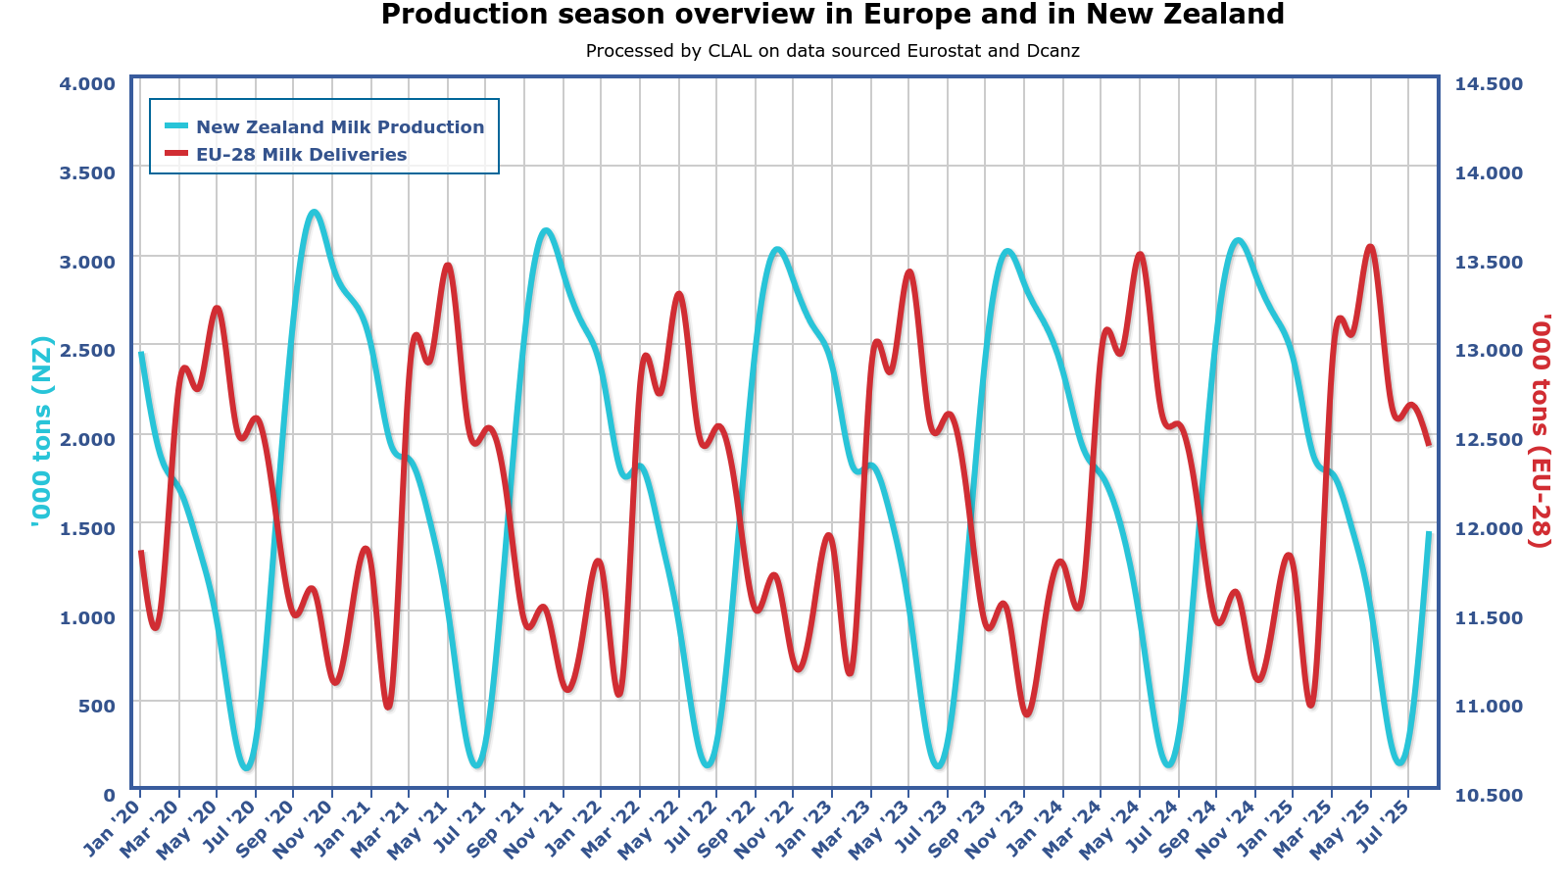
UNPROCESSED MILK MARKETS IN MAJOR DAIRY COUNTRIES
Graph 5
SEASONALITY OF UNPROCESSED MILK PRODUCTION IN NORTHERN AND SOUTHERN HEMISPHERES
Graph published by CLAL.it.

Slide 17
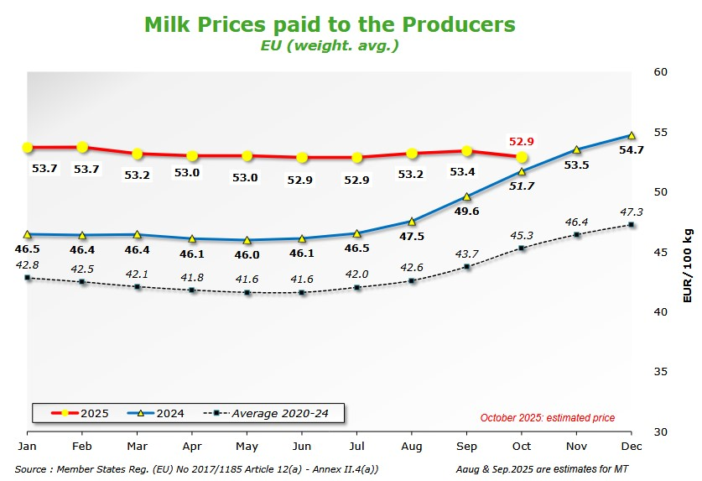
Graph 6
UNPROCESSED MILK PRICES IN THE EUROPEAN UNION
Graph published by EU Prices of Cows milk in Euro/100g. Europa.eu

Slide 18
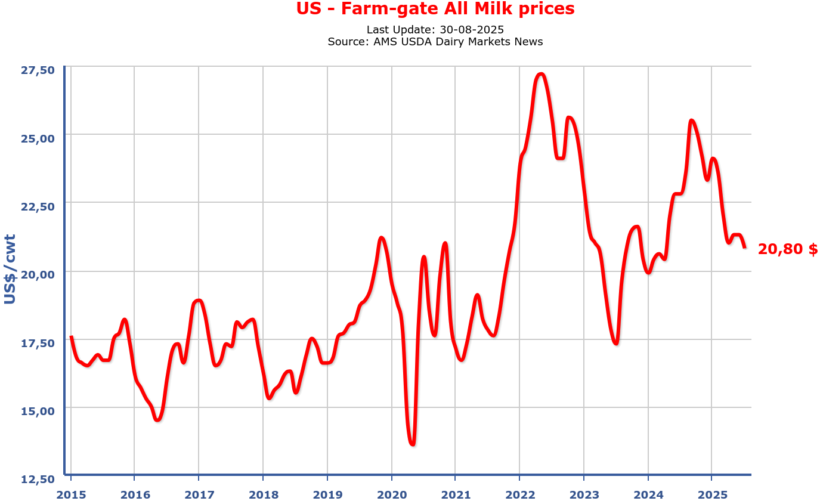
Graph 7
UNPROCESSED MILK PRICES IN THE USA
Graph published by CLAL.it.

Slide 19
Summary, unprocessed milk markets in major dairy
countries:
FAO expects that milk production in the world will increase by 1.8 percent per year in the next 10 years, but the production in the EU is expected to be stagnant.
Production per cow in the USA, is 4 times higher than the global average.
About 20 percent of cows are in Africa, but the production is 5% of the world’s production.
Prices in 2024 in the USA and in EU, increased significantly.
Price in EU in January to October 2025, moved sideways at lower levels than in December 2024 but higher than in 2024 January to October.
Prices in the USA from January to August 2025, decreased.
Price in the USA is very volatile.

Slide 20
CONDITIONS IN SOUTH AFRICA
  Uncertainty about political stability, policies, economic growth and improvement of service delivery, remains very high.
  Expected economic growth rate in 2025, according to the Reserve Bank:
    March 2025 1.7%
    May 2025 1.2%
    July 2025 0.9%
    September & October 2025 1.2%

Slide 21
CONDITIONS IN SOUTH AFRICA (CONTINUE)
  Expected economic growth rate in 2026:
      IMF 1.2%
      Minister of Finance 1.5%
  Expected economic growth rates in 2025 and 2026 are higher than 2024, but still low.
  At the end of 2025, more optimism due to, amongst others, the expected higher growth rate, low inflation and lower interest rates, but uncertainty is very high and predictability is low.

Slide 22
Table 5
THE GDP OF SOUTH AFRICA AT CONSTANT 2015 PRICES¹⁾
 | GDP
 | R million | Index
2018 | 4 571 783 | 100.0000
2019 | 4 583 667 | 100.2599
2020 | 4 300 904 | 94.0750
2021 | 4 509 870 | 98.6458
2022 | 4 602 690 | 100.6760
2023 | 4 639 792 | 101.4876
2024 ^{2&3)} | 4 664 608 | 102.0304
2025 Estimates
IMF ⁴⁾ | 4 715 919 | 103.1527
SA Reserve Bank ⁵⁾ | 4 720 583 | 103.2547
2026 Estimates
IMF ⁶⁾ | 4 772 510 | 104.3906
The Department: National Treasury⁷⁾ | 4 791 392 | 104.8036
1) Table prepared by the Office of SAMPRO based on information published by Statistics South Africa (Stats SA), the South African Reserve Bank (SARB) and the IMF. In respect of 2024, the IMF stated in January 2024 an expected growth rate of 1.0 percent, 0.9 percent in April 2024, 1.1 percent in October 2024 and 0.8 percent in January 2025. The actual growth rate in 2024 was 0,5349 percent (published on 3 June 2025 by Stats SA) In respect of 2024, the SARB stated in January 2024 an expected growth rate of 1.2 percent and in October 2024 1.1 percent. The actual growth rate in 2024 was 0.5349 percent In October 2024 and again in January 2025, the IMF stated an expected growth rate of 1.5 percent in 2025 but in April and July 2025 the IMF changed the expected growth rate to 1 percent. On 14 October 2025, the IMF changed it to 1.1 percent In March 2025, the Monetary Policy Committee (MPC) of the SARB predicted a growth rate of 1.7 percent for 2025 but in May 2025 the MPC changed it to 1.2 percent and on 31 July 2025, the MPC changed it to 0.9 percent. On 18 September 2025, the MPC changed it to 1.2 percent and confirmed their 1.2 percent estimate at their 23 October 2025 meeting. On 14 October 2025, the IMF stated an expected growth rate of 1.2 percent for 2026 The Department: National Treasury has predicted on 13 November 2025 a growth rate of 1.5 percent for 2026 in the Medium-Term Budget

Slide 23
Table 6
INDICES OF RATE OF UNEMPLOYMENT⁴⁾ IN SOUTH AFRICA (FIRST QUARTER 2015 = 100)
YEAR | QUARTER 1 | QUARTER 2 | QUARTER 3 | QUARTER 4 | AVERAGE⁵⁾
2015 | 100.00 | 94.64 | 96.59 | 92.80 | 96.00
2016 | 101.13 | 100.75 | 102.65 | 100.37 | 101.22
2017 | 104.92 | 104.92 | 104.92 | 101.13 | 103.97
2018 | 101.13 | 103.03 | 104.16 | 102.65 | 102.74
2019 | 104.54 | 109.84 | 110.22 | 110.22 | 108.70
2020 | 114.01 | 88.25 | 116.66 | 123.10 | 110.50
2021 | 123.48 | 130.30 | 132.19 | 133.71 | 129.92
2022 | 130.68 | 128.40 | 124.62 | 123.86 | 126.89
2023 | 124.62 | 123.48 | 120.83 | 121.54 | 122.63
2024 | 124.62 | 126.89 | 121.59 | 120.83 | 123.49
2025 | 124.62 | 125.76 | 120.83
4) Table prepared by the Office of SAMPRO based on information published by Statistics South Africa in its STATISTICAL RELEASE P0211 titled “Quarterly Labour Force Survey Quarter 3, 2025” and previous editions of PO211. 5) Average calculated by the Office of SAMPRO by dividing the sum of the quarterly figures of the year by four.

Slide 24
Improvement of service delivery by public sector is a prerequisite for higher economic growth.
The truth that economic growth, lower unemployment and transformation are dependent on improvement of the competitiveness (productivity) of the public and private sectors, does not receive enough attention in the determination of government policies and measures and in public debates.

Slide 25
THE UNPROCESSED MILK MARKET IN SOUTH AFRICA
Table 7
TOTAL QUANTITY OF UNPROCESSED MILK PURCHASED IN SOUTH AFRICA DURING THE
YEARS 2008 TO 2024
YEAR | UNPROCESSED MILK KILOGRAM | PERCENTAGE CHANGE FROM PREVIOUS YEAR | INDEX 2008 = 100
2008 | 2 624 511 678 | 2.50 | 100.00
2009 | 2 586 868 067 | -1.43 | 98.57
2010 | 2 711 236 032 | 4.81 | 103.30
2011 | 2 720 402 147 | 0.34 | 103.65
2012 | 2 842 810 159 | 4.50 | 108.32
2013 | 2 905 811 947 | 2.22 | 110.72
2014 | 2 982 734 569 | 2.65 | 113.65
2015 | 3 172 655 770 | 6.37 | 120.89
2016 | 3 158 466 390 | -0.45 | 120.34
2017 | 3 253 682 081 | 3.02 | 123.97
2018 | 3 410 535 904 | 4.82 | 129.95
2019 | 3 432 802 396 | 0.65 | 130.80
2020 | 3 427 335 378 | -0.16 | 130.56
2021 | 3 403 100 413 | -0.71 | 129.67
2022 | 3 349 861 004 | -1.56 | 127.64
2023 | 3 339 272 379 | -0.32 | 127.23
2024 | 3 458 059 966 | 3.56 | 131.76
Table prepared by the Office of SAMPRO based on information obtained from Milk SA

Slide 26
Table 8
AVERAGE AGGREGATE COMPOUND GROWTH RATE PER YEAR OF THE MASS OF PRODUCTION OF
UNPROCESSED MILK IN SOUTH AFRICA
Years | Average aggregate compound growth rate per year Percent
2008 to 2011 (3 years) | 1.20
2011 to 2014 (3 years) | 3.12
2014 to 2017 (3 years) | 2.94
2017 to 2020 (3 years) | 1.75
2020 to 2023 (3 years) | -0.86
2008 to 2023 (15 years) | 1.52
Table prepared by the Office of SAMPRO based on information obtained from Milk SA.

Slide 27
Table 9
DIFFERENCE BETWEEN THE HIGHEST AND LOWEST MASS OF PRODUCTION OF UNPROCESSED MILK PER DAY IN SOUTH AFRICA, IN THE YEARS 2009 TO 2024
Year | Percent
2009 | 35.3
2010 | 32.2
2011 | 32.0
2012 | 29.0
2013 | 29.9
2014 | 37.7
2015 | 25.2
2016 | 32.9
2017 | 39.5
2018 | 35.3
2019 | 35.3
2020 | 36.3
2021 | 40.9
2022 | 39.9
2023 | 40.7
2024 | 41,3
Average 2009 to 2024 | 35.2
Table prepared by the Office of SAMPRO based on information obtained from Milk SA.

Slide 28
Graph 8
Graph prepared by the Office of SAMPRO based on information obtained from MILK SA. The information in respect of 2019 to September 2025, is in respect of the total unprocessed milk purchased by all registered unprocessed milk buyers, declared in terms of Regulation 1652 of the Marketing of Agricultural Products Act and previous similar regulations. The figures for August and September 2025, are estimated figures determined on the assumption that the market share of the sample in the total unprocessed milk purchased is 89.19 percent, as was the case in the three-month period, May to July 2025

Slide 29
Table 10
MASS OF UNPROCESSED MILK PURCHASES IN PARTICULAR MONTHS, RELATIVE TO THE PURCHASES IN THE SAME MONTHS OF PARTICULAR PREVIOUS YEARS
 | Percentage increase
January 2023 relative to January 2022 | -3.2
February 2023 relative to February 2022 | -1.5
March 2023 relative to March 2022 | -0.7
April 2023 relative to April 2022 | 0.7
May 2023 relative to May 2022 | -1.1
June 2023 relative to June 2022 | -0.6
July 2023 relative to July 2022 | -2.2
August 2023 relative to August 2022 | -0.6
September 2023 relative to September 2022 | 0.1
October 2023 relative to October 2022 | -0.1
November 2023 relative to November 2022 | 1.8
December 2023 relative to December 2022 | 2.8
January 2024 relative to January 2023 | 2.6
February 2024 relative to February 2023 | 1.5
March 2024 relative to March 2023 | 1.4
April 2024 relative to April 2023 | 2.2
May 2024 relative to May 2023 | 6.7
June 2024 relative to June 2023 | 3.4
July 2024 relative to July 2023 | 3.7
August 2024 relative to August 2023 | 2.0
September 2024 relative to September 2023 | 2.4
October 2024 relative to October 2023 | 3.9
November 2024 relative to November 2023 | 5.4
December 2024 relative to December 2023 | 4.2
January 2025 relative to January 2024 | 1.9
February 2025 relative to February 2024 | 4.3
March 2025 relative to March 2024 | 2.0
April 2025 relative to April 2024 | -0.9
May 2025 relative to May 2024 | -3.4
June 2025 relative to June 2024 | -0.4
July 2025 relative to July 2024 | 1.0
August 2025 relative to August 2024 (est) | 4.1
September 2025 relative to September 2024 (est) | 4.5
Table prepared by the Office of SAMPRO based on information obtained from Milk SA and the figures for August and September 2025 are estimates.

Slide 30
Table 11
UNPROCESSED MILK PURCHASES PER QUARTER OF EACH OF THE YEARS 2009 TO THE THIRD QUARTER OF 2025
UNPROCESSED MILK PURCHASES PER QUARTER OF EACH OF THE YEARS 2009 to 2025
Year | Quarter 1 |  |  | Quarter 2 |  | Quarter 3 |  | Quarter 4 |  |  | Total
 | Kg |  | % | Kg | % | Kg | % | Kg |  | % | Kg | %
2009 | 620 043 005 |  | 23.969 | 560 531 455 | 21.668 | 658 577 140 | 25.458 | 747 716 467 |  | 28.904 | 2 586 868 067 | 100
2010 | 640 933 409 |  | 23.640 | 595 998 091 | 21.983 | 699 002 502 | 25.782 | 775 302 030 |  | 28.596 | 2 711 236 032 | 100
2011 | 654 701 438 |  | 24.066 | 597 343 799 | 21.958 | 694 671 935 | 25.536 | 773 684 975 |  | 28.440 | 2 720 402 147 | 100
2012 | 676 129 726 |  | 23.784 | 638 011 059 | 22.443 | 725 458 007 | 25.519 | 803 211 367 |  | 28.254 | 2 842 810 159 | 100
2013 | 683 707 219 |  | 23.529 | 646 811 485 | 22.259 | 746 796 407 | 25.700 | 828 496 836 |  | 28.512 | 2 905 811 947 | 100
Total (2009-2013) | 3 275 514 797 |  | 23.792 | 3 038 695 889 | 22.072 | 3 524 505 991 | 25.601 | 3 928 411 675 |  | 28.535 | 13 767 128 352 | 100
Year | Quarter 1 |  |  | Quarter 2 |  | Quarter 3 |  | Quarter 4 |  |  | Total
 | Kg |  | % | Kg | % | Kg | % | Kg |  | % | Kg | %
2014 | 683 060 914 |  | 22.900 | 650 998 523 | 21.826 | 766 083 031 | 25.684 | 882 592 129 |  | 29.590 | 2 982 734 597 | 100
2015 | 770 769 019 |  | 24.294 | 726 975 249 | 22.914 | 799 968 233 | 25.214 | 874 943 269 |  | 27.578 | 3 172 655 770 | 100
2016 | 743 935 710 |  | 23.816 | 701 859 008 | 22.222 | 806 386 965 | 25.531 | 897 973 819 |  | 28.431 | 3 150 155 502 | 100
2017 | 756 689 792 |  | 23.256 | 703 893 532 | 21.634 | 837 867 145 | 25.751 | 955 231 612 |  | 29.358 | 3 253 682 081 | 100
2018 | 814 831 903 |  | 23.892 | 750 437 490 | 22.004 | 873 519 325 | 25.612 | 971 747 186 |  | 28.493 | 3 410 535 904 | 100
Total (2014-2018) | 3 769 287 338 |  | 23.630 | 3 534 163 802 | 22.130 | 4 083 824 699 | 25.572 | 4 582 488 015 |  | 28.695 | 15 969 763 854 | 100
Year | Quarter 1 |  |  | Quarter 2 |  | Quarter 3 |  | Quarter 4 |  |  | Total
 | Kg |  | % | Kg | % | Kg | % | Kg |  | % | Kg | %
2019 | 816 208 186 |  | 23.777 | 757 906 127 | 22.078 | 882 584 853 | 25.710 | 976 103 230 |  | 28.435 | 3 432 802 396 | 100
2020 | 831 232 775 |  | 24.253 | 744 621 901 | 21.726 | 874 078 494 | 25.503 | 977 402 208 |  | 28.518 | 3 427 335 378 | 100
2021 | 791 682 285 |  | 23.264 | 739 610 710 | 21.733 | 874 291 459 | 25.691 | 997 515 959 |  | 29.312 | 3 403 100 413 | 100
2022 | 792 616 775 |  | 23.661 | 724 752 937 | 21.635 | 879 548 171 | 26.256 | 952 943 120 |  | 28.448 | 3 349 861 004 | 100
2023 | 777 738 787 |  | 23.291 | 722 335 713 | 21.632 | 872 561 910 | 26.130 | 966 635 969 |  | 28.948 | 3 339 272 379 | 100
Total (2019-2023) | 4 009 578 807 |  | 23.651 | 3 689 227 388 | 21.762 | 4 383 064 887 | 25.855 | 4 870 600 486 |  | 28.731 | 16 952 371 569 | 100
Total (2009-2023) | 11 054 280 942 |  | 23.676 | 10 262 087 079 | 21.980 | 11 991 395 576 | 25.683 | 13 381 500 176 |  | 28.661 | 46 689 263 773 | 100
2024 | 800 881 701 |  | 23.160 | 751 811 286 | 21.741 | 895 542 213 | 25.897 | 1 009 824 767 |  | 29.202 | 3 458 059 966 | 100
2025 | 813 414 908 |  |  | 739 855 428 |  | 925 189 000
Table prepared by the Office of SAMPRO based on information obtained from Milk SA.

Slide 31
Table 12
DECREASE IN THE MONTHLY UNPROCESSED MILK PURCHASES IN SOUTH AFRICA, FROM OCTOBER TO DECEMBER, OCTOBER TO FEBRUARY, OCTOBER TO APRIL AND OCTOBER TO JUNE, IN THE YEARS 2008 TO 2025
Year | October to December percent | October to February percent | October to April percent | October to June percent
2008/9 | 5.5 | 16.9 | 24.4 | 25.4
2009/10 | 3.9 | 14.6 | 20.4 | 21.2
2010/11 | 5.0 | 15.6 | 23.4 | 23.7
2011/12 | 5.6 | 14.5 | 19.5 | 18.2
2012/13 | 6.6 | 14.9 | 20.9 | 20.5
2013/14 | 5.3 | 18.0 | 22.9 | 21.8
2014/15 | 4.2 | 12.9 | 17.1 | 19.4
2015/16 | 7.7 | 15.9 | 20.5 | 22.0
2016/17 | 7.9 | 17.8 | 22.2 | 24.9
2017/18 | 4.0 | 13.8 | 18.7 | 23.3
2018/19 | 5.7 | 16.8 | 21.9 | 25.6
2019/20 | 7.3 | 17.4 | 24.4 | 26.2
2020/21 | 7.8 | 21.2 | 24.2 | 27.7
2021/22 | 8.2 | 23.0 | 27.6 | 30.3
2022/23 | 11.5 | 22.2 | 25.2 | 29.0
2023/24 | 9.0 | 20.8 | 23.7 | 27.0
2024/25 | 8.7 | 20.6 | 27.1 | 29.5
Average 2008/9 to 2024/25 | 6.7 | 17.5 | 22.6 | 24.1
Table prepared by the Office of SAMPRO on the basis of information obtained from MILK SA. The information in respect of 2008 to 2025, is in respect of the total unprocessed milk purchased by all registered milk buyers declared in terms of Regulation 1652 of the Marketing of Agricultural Products Act and previous similar regulations

Slide 32
Table 13
INCREASE IN THE MASS OF MONTHLY UNPROCESSED MILK PURCHASES IN SOUTH AFRICA, FROM
JULY TO AUGUST, JULY TO SEPTEMBER AND JULY TO OCTOBER IN EACH OF THE YEARS 2008 TO 2025
Year | July to August Percent | July to September Percent | July to October Percent
2008 | 10.8 | 22.2 | 24.6
2009 | 12.4 | 24.5 | 29.3
2010 | 9.7 | 19.8 | 24.2
2011 | 10.6 | 26.3 | 28.2
2012 | 10.3 | 21.8 | 25.6
2013 | 11.4 | 23.0 | 26.4
2014 | 13.0 | 27.2 | 32.9
2015 | 10.6 | 20.7 | 25.1
2016 | 12.9 | 27.3 | 30.8
2017 | 15.7 | 28.7 | 32.0
2018 | 13.6 | 24.7 | 29.0
2019 | 16.0 | 28.1 | 30.8
2020 | 14.5 | 27.2 | 31.9
2021 | 15.1 | 30.1 | 35.8
2022 | 16.8 | 29.3 | 31.9
2023 | 18.9 | 32.4 | 34.9
2024 | 16.9 | 32.9 | 35.0
Average 2008 to 2025 | 13.5 | 26.2 | 30.0
2025 (estimate) | 20.4 | 35.3
Table prepared by the Office of SAMPRO on the basis of information obtained from MILK SA. The information in respect of 2008 to 2025, is in respect of the total unprocessed milk purchased by all registered milk buyers declared in terms of Regulation 1652 of the Marketing of Agricultural Products Act and previous similar regulations.
July to August and September are estimated figures.

Slide 33
Graph 9
Graph prepared by the Office of SAMPRO and is based on the information as published by Statistics SA.

Slide 34
Table 14
MONTHLY INCREASE IN THE PRODUCER PRICE INDEX OF UNPROCESSED MILK
Index: Dec 2016=100
Percentage increase
January 2023 relative to December 2022 | 2.29
February 2023 relative to January 2023 | 4.48
March 2023 relative to February 2023 | 5.81
April 2023 relative to March 2023 | 2.16
May 2023 relative to April 2023 | -0.38
June 2023 relative to May 2023 | 1.09
July 2023 relative to June 2023 | -0.76
August 2023 relative to July 2023 | -3.01
September 2023 relative to August 2023 | -1.25
October 2023 relative to September 2023 | 0.87
November 2023 relative to October 2023 | -0.20
December 2023 relative to November 2023 | 0.33
January 2024 relative to December 2023 | 1.32
February 2024 relative to January 2024 | 0.39
March 2024 relative to February 2024 | 1.76
April 2024 relative to March 2024 | 3.13
May 2024 relative to April 2024 | -1.24
June 2024 relative to May 2024 | 0.00
July 2024 relative to June 2024 | -0.75
August 2024 relative to July 2024 | -6.01
September 2024 relative to August 2024 | -0.54
October 2024 relative to September 2024 | 0.34
November 2024 relative to October 2024 | -2.76
December 2024 relative to November 2024 | -0.42
January 2025 relative to December 2024 | 0.84
February 2025 relative to January 2025 | 1.04
March 2025 relative to February 2025 | 3.00
April 2025 relative to March 2025 | 0.80
May 2025 relative to April 2025 | 3.29
June 2025 relative to May 2025 | 0.19
July 2025 relative to June 2025 | -0.96
August 2025 relative to July 2025 | -2.04
September 2025 relative to August 2025 | -2.97
Table prepared by the Office of SAMPRO based on information published by Statistics SA.

Slide 35
Table 15
THE DIFFERENCE BETWEEN THE HIGHEST AND LOWEST PRODUCER PRICE INDEX OF UNPROCESSED MILK IN SOUTH AFRICA IN EACH OF THE YEARS 2015 TO 2024
Index: Dec 2016=100
Year | Percent
2015 (Highest in May and June, Lowest in December) | 18.2
2016 (Highest in October, Lowest in January) | 22.5
2017 (Highest in October and November, Lowest in February) | 6.5
2018 (Highest in March, Lowest in December) | 18.1
2019 (Highest in April, Lowest in January) | 12.0
2020 (Highest in December, Lowest in January) | 10.7
2021 (Highest in June, Lowest in January) | 12.8
2022 (Highest in December, Lowest in January) | 12.2
2023 (Highest in June, Lowest in January) | 13.7
2024 (Highest in April, Lowest in December) | 12.3
Average | 13.9
Table prepared by the Office of SAMPRO based on information published by Statistics SA.

Slide 36
Graph 10
Graph prepared by the Office of SAMPRO and is based on the information as published by Statistics SA.

Slide 37
Graph 11
INCREASE IN UNPROCESSED MILK PURCHASES RELATIVE TO PREVIOUS YEAR (PERCENT)²³⁾
2012 | 2013 | 2014 | 2015 | 2016 | 2017 | 2018 | 2019 | 2020 | 2021 | 2022 | 2023 | 2024
4.5 | 2.22 | 2.65 | 6.37 | -0.45 | 3.02 | 4.82 | 0.65 | -0.16 | -0.71 | -1.56 | -0.32 | 3.56
23) The combined maize and soya price index is an index of prices equal to 70 percent of the maize price, plus 30 percent of the soya price.
Graph prepared by the Office of SAMPRO based on information obtained from Statistics SA, SAFEX middle of the month prices and unprocessed milk purchases from Milk SA.

Slide 38
Table 16
FUTURE PRICES OF YELLOW MAIZE IN SOUTH AFRICA (R/TON) ON 12 SEPTEMBER 2025 AND
10 NOVEMBER 2025, ACCORDING TO GRAIN SA
 | A CLOSING BID 12 September 2025 R/Ton | B CLOSING BID 10 November 2025 R/Ton | C Percentage change from A to B
^{November 2025} |  | ³ ⁴⁸⁰
^{December 2025} | ³ ⁷²³ | ³ ⁵⁰⁵ | ^{-5.9}
^{March 2026} | ³ ⁷⁵⁰ | ³ ⁵¹² | ^{-6.3}
^{May 2026} | ³ ⁷⁴⁶ | ³ ⁵⁰³ | ^{-6.5}
^{July 2026} |  | ³ ⁵¹⁵
^{September 2026} |  | ³ ⁶²⁰
Table prepared by the Office of SAMPRO based on information as obtained from the GRAIN SA website

Slide 39
Table 17
FUTURE PRICES OF SOYBEANS IN SOUTH AFRICA (R/TON) ON 12 SEPTEMBER 2025 AND
10 NOVEMBER 2025, ACCORDING TO GRAIN SA
 | A CLOSING BID 12 September 2025 R/Ton | B CLOSING BID 10 November 2025 R/Ton | C Percentage change from A to B
^{November 2025} | ⁷ ³⁴² | ⁷ ²⁴⁴ | ^{-1.3}
^{December 2025} | ⁷ ⁴¹⁶ | ⁷ ²⁸¹ | ^{-1.8}
^{March 2026} | ⁷ ⁴¹¹ | ⁷ ²⁹⁴ | ^{-1.6}
^{May 2026} | ⁷ ⁴⁰¹ | ⁷ ²⁵⁵ | ^{-2.0}
^{July 2026} |  | ⁷ ⁴⁷⁵
^{September 2026} |  | ⁷ ⁶¹⁹
Table prepared by the Office of SAMPRO based on information as obtained from the GRAIN SA website

Slide 40
Table 18
FERTILIZER PRICES IN SOUTH AFRICA
^{Fertilizer} | ^{September 2024} ^{Rand / Ton} | ^{September 2025} ^{Rand / Ton} | Percentage change from September 2024 to September 2025
^{MAP} | ¹⁶ ⁰⁶⁷ | ¹⁸ ²⁷⁵ | ^{13.8}
^{LAN (28)} | ⁹ ⁴²² | ¹⁰ ⁵³⁸ | ^{11.8}
^{Urea (46)} | ⁹ ⁸⁷³ | ¹² ²⁵⁴ | ^{24.1}
^{KCL} | ⁸ ⁹⁵⁰ | ⁹ ⁸⁹⁸ | ^{10.6}
Table prepared by the Office of SAMPRO based on information published by Grain SA

Slide 41
Table 19
FERTILIZER PRICES IN SOUTH AFRICA
^{Fertilizer} | ^{August 2025} ^{Rand / Ton} | ^{September 2025} ^{Rand / Ton} | Percentage change from August 2025 to September 2025
^{MAP} | ¹⁸ ⁶⁴⁷ | ¹⁸ ²⁷⁵ | ^{-2.0}
^{LAN (28)} | ¹⁰ ⁴¹³ | ¹⁰ ⁵³⁸ | ^{1.2}
^{Urea (46)} | ¹² ²⁷⁶ | ¹² ²⁵⁴ | ^{-0.2}
^{KCL} | ¹⁰ ⁰⁵⁹ | ⁹ ⁸⁹⁸ | ^{-1.6}
Table prepared by the Office of SAMPRO based on information published by Grain SA

Slide 42
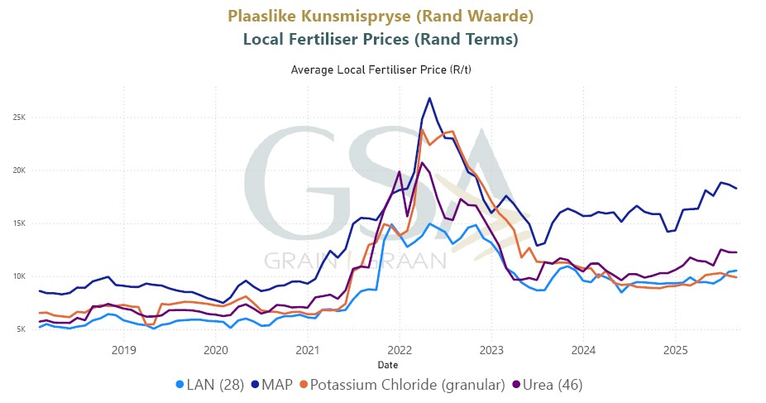
Graph 12
Graph as published by Grain SA

Slide 43
Table 20
INCREASE IN THE PRODUCER PRICE INDICES OF UNPROCESSED MILK AND DAIRY PRODUCTS
INDEX 2016 = 100
 | Unprocessed milk Percentage increase | Dairy Products Percentage increase
August to September 2025 | -3.0 | 0.1
June to September 2025 (3-month period) | -5.9 | 0.7
March to September 2025 (6-month period) | -1.8 | 1.3
September 2024 to September 2025 (12-month period) | 0.1 | 1.0
September 2023 to September 2025 (24-month period) | -1.1 | 4.1
September 2022 to September 2025 (36-month period) | 10.9 | 6.7
September 2021 to September 2025 (48-month period) | 28.0 | 25.4
January 2012 to September 2025 (164-month period) | 123.6 | 119.6
The producer price index of dairy products reflects the changes in the producer prices of pasteurised and UHT milk, yoghurt, cheddar cheese and ice cream and not that of the other dairy products like maas, cheese other than cheddar cheese and milk powder.
Table prepared by the Office of SAMPRO based on information published by Statistics SA.

Slide 44
Graph 13
Graph prepared by the Office of SAMPRO based on information published by Statistics SA

Slide 45
Summary of unprocessed milk market in sa
Production of unprocessed milk.
  Decreased in the 4 years (2020 – 2023);
  In 2023, lower than in the previous 5 years (2018 – 2022);
  In 2024, higher than in each of the previous 16 years; and
  In 6 of the first 9 months of 2025, higher;
  In 20 of the last 23 months, higher; and
  Seasonal increase from July 2025 to September 2025 of 35.0% (estimated figures)higher than the average of 26,2% in the 17 years (2008 to 2024) and the highest in the 17 years (2008 to 2023).
Producer price index increased in the first 6 months of 2025, but decreased in the 3 months up to September 2025.
Producer price index in the first 9 months of 2025, moved close to indices in 2023 and 2024, which suggests slight supply side pressure.

Slide 46
Prices of maize and soybeans, which are a major source of ingredients for concentrated feed, decreased significantly.
Favourable relationship between producer price index of unprocessed milk and the index of the combined yellow maize and soybean price, disappeared at the end of 2024, but appeared again in 2025 and moved to a more favourable position.
High increase in electricity and water prices and increased fertilizer prices.
Prevention of the spread of Foot and Mouth Disease is of critical importance.
Uncertainty about future weather conditions and the impact of it on the production of unprocessed milk.
Future demand for unprocessed milk will be determined by future sales of dairy products.

Slide 47
SOUTH AFRICAN MARKETS FOR DAIRY PRODUCTS
Table 21
MASS OF IMPORT IN 2021, 2022, 2023, 2024 AND 2025 (Est)
Product | A 2021 Ton | B 2022 Ton | C 2023 Ton | D 2024 Ton | E 2025 (Est) Ton
(04.01) Milk and cream | 22 918 | 3 965 | 5 760 | 329 | 160
(04.02) Concentrated milk | 19 393 | 15 988 | 18 881 | 12 174 | 12 758
(04.03) Buttermilk and yoghurt | 3 362 | 3 387 | 4 041 | 4 745 | 5 014
(04.04) Whey | 17 056 | 18 436 | 11 589 | 10 995 | 8 671
(04.05) Butter | 4 419 | 3 602 | 1 527 | 1 237 | 341
(04.06) Cheese | 8 471 | 7 540 | 6 670 | 4 429 | 3 846
Table prepared by the Office of SAMPRO based on information published by SARS and estimated figures calculated by the Office of SAMPRO.

Slide 48
Table 22
MASS OF EXPORT IN 2021, 2022, 2023, 2024 AND 2025 (Est)
Product | A 2021 Ton | B 2022 Ton | C 2023 Ton | D 2024 Ton | E 2025 (Est) Ton
(04.01) Milk and cream | 24 062 | 21 544 | 23 039 | 20 166 | 20 535
(04.02) Concentrated milk | 7 528 | 10 422 | 10 844 | 11 736 | 17 838
(04.03) Buttermilk and yoghurt | 10 325 | 10 472 | 11 669 | 9 726 | 10 295
(04.04) Whey | 1 920 | 1 931 | 1 811 | 1 752 | 2 378
(04.05) Butter | 1 298 | 1 226 | 1 049 | 1 395 | 2 372
(04.06) Cheese | 5 857 | 6 349 | 7 662 | 8 773 | 12 648
Table prepared by the Office of SAMPRO based on information published by SARS and estimated figures calculated by the Office of SAMPRO.

Slide 49
Table 23
AVERAGE IMPORT AND EXPORT PRICES (F.O.B.) OF THE DIFFERENT TYPES OF DAIRY PRODUCTS, BY SOUTH AFRICA, IN 2024 AND 2025 (JANUARY TO SEPTEMBER)
PRODUCT | Import Price (f.o.b.) R/kg |  | Export Price (f.o.b.) R/kg
 | 2024 | 2025 (Jan to Sep) | 2024 | 2025 (Jan to Sep)
(04.01) Milk and Cream | 48.22 | 53.66 | 18.42 | 17.88
(04.02) Concentrated Milk | 55.25 | 61.48 | 66.69 | 66.43
(04.03) Buttermilk and Yoghurt | 43.81 | 48.00 | 29.27 | 29.75
(04.04) Whey | 34.42 | 40.37 | 24.25 | 23.05
(04.05) Butter and Oils | 115.25 | 168.73 | 96.97 | 104.82
(04.06) Cheese | 129.17 | 137.65 | 78.31 | 81.64
Table prepared by the Office of SAMPRO based on information published by SARS

Slide 50
Table 24
TOTAL IMPORT AND EXPORT OF DAIRY PRODUCTS BY SOUTH AFRICA AND THE EXPOSURE OF THE SOUTH AFRICAN DAIRY INDUSTRY TO INTERNATIONAL COMPETITION
(INDEX OF THE SUM OF THE MASS OF IMPORTS AND EXPORTS)
INDEX: 2002 = 100
YEAR | IMPORT |  | EXPORT |  | IMPORT PLUS EXPORT
 | TON | INDEX | TON | INDEX | TON | INDEX
2002 | 24 617.40 | 100.0 | 34 328.20 | 100.0 | 58 945.60 | 100.0
2003 | 24 458.80 | 99.4 | 22 905.20 | 66.7 | 47 364.00 | 80.4
2004 | 18 289.50 | 74.3 | 23 508.10 | 68.5 | 41 797.60 | 70.9
2005 | 30 771.40 | 125.0 | 17 216.00 | 50.2 | 47 987.40 | 81.4
2006 | 30 878.60 | 125.4 | 26 543.30 | 77.3 | 57 421.90 | 97.4
2007 | 44 313.00 | 180.0 | 18 516.50 | 53.9 | 62 829.50 | 106.6
2008 | 34 009.40 | 138.2 | 42 781.00 | 124.6 | 76 790.40 | 130.3
2009 | 32 373.40 | 131.5 | 41 770.70 | 121.7 | 74 144.10 | 125.8
2010 | 35 061.20 | 142.4 | 33 950.60 | 98.9 | 69 011.80 | 117.1
2011 | 37 714.40 | 153.2 | 41 817.10 | 121.8 | 79 531.50 | 134.9
2012 | 59 102.53 | 240.1 | 52 500.96 | 152.9 | 111 513.49 | 189.2
2013 | 35 673.76 | 144.9 | 70 481.90 | 205.3 | 106 155.66 | 180.1
2014 | 40 199.03 | 163.3 | 71 098.95 | 207.1 | 111 297.98 | 188.8
2015 | 69 353.98 | 281.7 | 61 296.87 | 178.6 | 130 650.85 | 221.6
2016 | 58 000.35 | 235.6 | 50 247.54 | 146.4 | 108 247.89 | 183.6
2017 | 83 504.44 | 339.2 | 48 626.69 | 141.7 | 132 131.13 | 224.2
2018 | 68 652.58 | 278.9 | 45 257.49 | 131.8 | 113 910.08 | 193.2
2019 | 75 596.08 | 307,1 | 45 051.75 | 131.2 | 120 647.83 | 204.7
2020 | 60 579.33 | 246.1 | 46 695.39 | 136.0 | 107 274.72 | 182.0
2021 | 75 618.94 | 307.2 | 50 990.95 | 148.5 | 126 609.89 | 214.8
2022 | 52 917.65 | 215.0 | 51 944.67 | 151.4 | 104 862.32 | 177.9
2023 | 48 468.87 | 196.9 | 56 074.63 | 163.3 | 104 543.50 | 177.4
2024 | 33 909.33 | 137.7 | 53 547.92 | 156.0 | 87 457.25 | 148.4
Table prepared by the Office of SAMPRO based on information published by SARS and estimated figures calculated by the Office of SAMPRO.

Slide 51
Table 25
MASS OF IMPORT AS PERCENTAGE OF THE MASS OF EXPORT, OF THE DIFFERENT TYPES OF DAIRY PRODUCTS BY SOUTH AFRICA
Heading | Description | 2017 | 2018 | 2019 | 2020 | 2021 | 2022 | 2023 | 2024 | 2025 (Est)
04.01 | Milk and cream, unsweetened | 217.1 | 103.7 | 90.2 | 26.4 | 95.2 | 18.4 | 25.0 | 1.6 | 0.8
04.02 | Milk, concentrated | 146.4 | 159.5 | 227.9 | 252.8 | 257.6 | 153.4 | 174.1 | 103.7 | 71.5
04.03 | Buttermilk powder, yoghurt | 28.4 | 27.9 | 31.7 | 40.3 | 32.6 | 32.3 | 34.6 | 48.8 | 48.7
04.04 | Whey, whey powder, etc | 192.9 | 1 741.3 | 2 917.9 | 1 257.6 | 888.3 | 954.9 | 640.0 | 627.6 | 364.6
04.05 | Butter, butter spreads and butter oil | 491.2 | 735.1 | 355.5 | 540.6 | 340.4 | 293.9 | 145.6 | 88.7 | 14.4
04.06 | Cheese and curd | 338.7 | 272.5 | 252.7 | 141.7 | 144.6 | 118.7 | 87.0 | 50.5 | 30.4
TOTAL |  | 171.7 | 151.7 | 167.8 | 129.7 | 148.3 | 101.9 | 86.4 | 43.3 | 46.6
Table prepared by the Office of SAMPRO based on information published by SARS and estimated figures calculated by the Office of SAMPRO.

Slide 52
Graph 14
The producer price index of dairy products reflects the changes of the producer prices of pasteurised and UHT milk, yoghurt, cheddar cheese and ice cream and not that
of the other dairy products like maas, cheese other than cheddar cheese and milk powder.
Graph prepared by the Office of SAMPRO based on information published by Statistics SA

Slide 53
Table 26
THE DIFFERENCES BETWEEN THE HIGHEST AND LOWEST PRODUCER PRICE INDEX OF DAIRY PRODUCTS IN SOUTH AFRICA, IN EACH OF THE YEARS 2015 TO 2024
Index: Dec 2016=100
Year | Percent difference
2015 (Highest in May, Lowest in January) | 4.0
2016 (Highest in September, Lowest in January) | 14.0
2017 (Highest in December, Lowest in March) | 3.0
2018 (Highest in May, Lowest in October) | 3.9
2019 (Highest in September, Lowest in April) | 3.3
2020 (Highest in May, Lowest in February) | 4.8
2021 (Highest in September, Lowest in January) | 8.9
2022 (Highest in October, Lowest in January) | 18.2
2023 (Highest in August, Lowest in January) | 5.1
2024 (Highest in June, Lowest in January) | 3.4
Average | 6.9
Table prepared by the Office of SAMPRO based on information published by SARS

Slide 54
Graph 15
Graph prepared by the Office of SAMPRO based on information published by Statistics SA

Slide 55
Graph 16
Graph prepared by the Office of SAMPRO based on information published by Statistics SA

Slide 56
Table 27
INCREASE IN PRODUCER PRICE INDICES OF PARTICULAR CATEGORIES OF PRODUCTS WHICH INCLUDE INPUTS OF THE DAIRY INDUSTRY, IN THE YEARS WHICH ENDED IN SEPTEMBER 2024 AND SEPTEMBER 2025
Table prepared by the Office of SAMPRO based on information published by Statistics SA

Slide 57
Table 28
CHANGES IN THE RETAIL SALES QUANTITIES FROM THE YEAR JULY 2023 TO JUNE 2024, TO THE YEAR JULY 2024 TO JUNE 2025; AND CHANGES IN THE RETAIL PRICES FROM JUNE 2024 TO JUNE 2025
PRODUCT | CHANGE IN RETAIL SALES QUANTITIES PERCENT | CHANGE IN RETAIL PRICES PERCENT
FRESH MILK | -0.7 | -2.4
LONG LIFE MILK (UHT MILK) | 5.7 | -1.3
FLAVOURED MILK | -0.8 | 7.9
YOGHURT | 3.5 | 2.7
MAAS | 7.3 | -0.5
PRE-PACKAGED CHEESE | 3.8 | 3.2
CREAM CHEESE | 3.9 | 3.3
CREAM | 5.1 | 0.9
Table prepared by the Office of SAMPRO based on the results of surveys by “NielsenIQ”. Non-retail sales such as sales to industrial buyers are not part of the surveys

Slide 58
Table 29
CHANGES IN THE QUANTITIES OF RETAIL SALES OF SPECIFIC DAIRY PRODUCTS IN SOUTH AFRICA
PRODUCT | Sales in the month of June 2025 versus the sales in the month of June 2024 | Sales in the 3 months from April 2025 to June 2025 versus the sales in the 3 months from April 2024 to June 2024 | Sales in the 6 months from January 2025 to June 2025 versus the sales in the 6 months from January 2024 to June 2024 | Sales in the 9 months from October 2024 to June 2025 versus the sales in the 9 months from October 2023 to June 2024 | Sales in the 12 months from July 2024 to June 2025 versus the sales in the 12 months from July 2023 to June 2024
 | percent | percent | percent | percent | percent
Fresh Milk | -0.2 | -0.9 | -0.3 | -0.6 | -0.7
UHT milk | 1.3 | 4.1 | 5.3 | 5.7 | 5.7
Flavoured milk | -2.6 | -3.0 | -1.0 | -1.0 | -0.8
Yoghurt | 4.2 | 2.8 | 3.0 | 3.4 | 3.5
Maas | 6.4 | 7.7 | 7.7 | 7.9 | 7.3
Pre-packaged cheese | -0.01 | 1.2 | 2.4 | 3.2 | 3.8
Cream cheese | 4.3 | 6.5 | 4.6 | 4.0 | 3.9
Cream | 4.3 | 5.2 | 6.7 | 5.6 | 5.1
Table prepared by the Office of SAMPRO based on the results of surveys by “NielsenIQ”. Non-retail sales such as sales to industrial buyers are not part of the surveys

Slide 59
Table 30
THE AVERAGE RETAIL PRICES OF SPECIFIC DAIRY PRODUCTS IN JUNE 2025, COMPARED TO THE AVERAGE RETAIL PRICES OF THE PRODUCTS CONCERNED IN SPECIFIC PREVIOUS MONTHS OF 2024 AND 2023
PRODUCT | June 2025 versus May 2025 (1 month ago) | June 2025 versus March 2025 (3 months ago) | June 2025 versus December 2024 (6 months ago) | June 2025 versus September 2024 (9 months ago) | June 2025 versus June 2024 (12 months ago) | June 2025 versus December 2023 (18 months ago) | June 2025 versus June 2023 (24 months ago)
 | Percent | Percent | Percent | Percent | Percent | Percent | Percent
FRESH MILK | -0.1 | -0.6 | -1.7 | -1.7 | -2.4 | -1.5 | -1.5
UHT MILK | -0.2 | 0.4 | 1.2 | -1.6 | -1.3 | -2.1 | -1.8
FLAVOURED MILK | -0.1 | 2.3 | 6.6 | 3.4 | 7.9 | 12.9 | 8.2
YOGHURT | -1.9 | 0.4 | 3.2 | 0.8 | 2.7 | 7.3 | 7.1
MAAS | -0.4 | -0.2 | 0.8 | -0.8 | -0.5 | 0.4 | 2.3
PRE-PACKAGED CHEESE | -0.7 | -0.1 | 1.6 | 3.4 | 3.2 | -1.0 | 9.5
CREAM CHEESE | 0.2 | 4.5 | 1.4 | 5.8 | 3.3 | 3.4 | 9.0
CREAM | -0.4 | 0.6 | 0.5 | 0.6 | 0.9 | 1.3 | 3.7
Table prepared by the Office of SAMPRO based on the results of surveys by “NielsenIQ”. Non-retail sales such as sales to industrial buyers are not part of the surveys

Slide 60
Graph 18
Graph prepared by the Office of SAMPRO based on information obtained from NielsenIQ

Slide 61
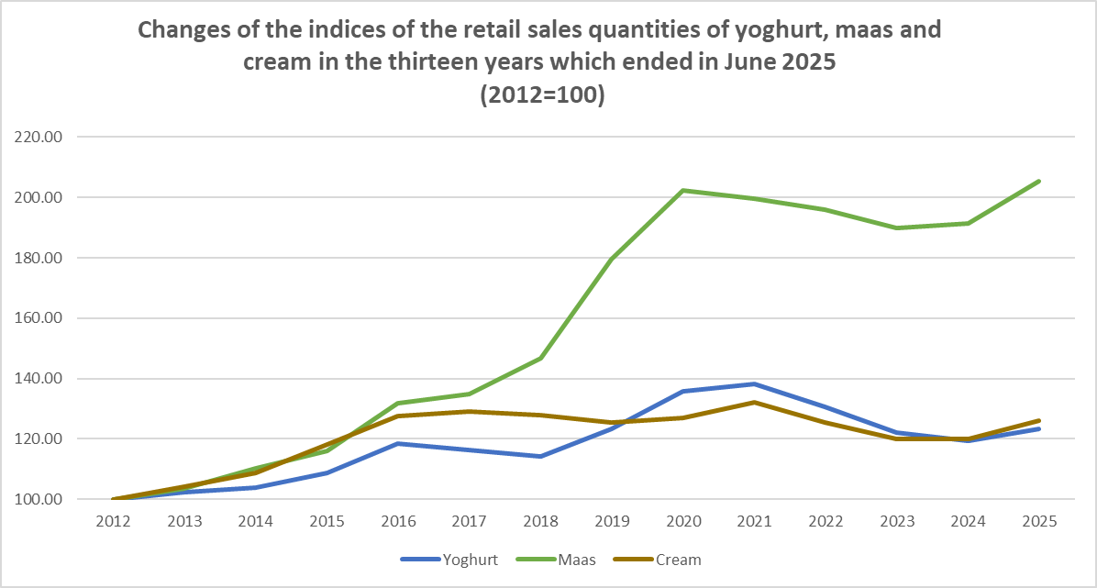
Graph 19
Graph prepared by the Office of SAMPRO based on information obtained from NielsenIQ

Slide 62
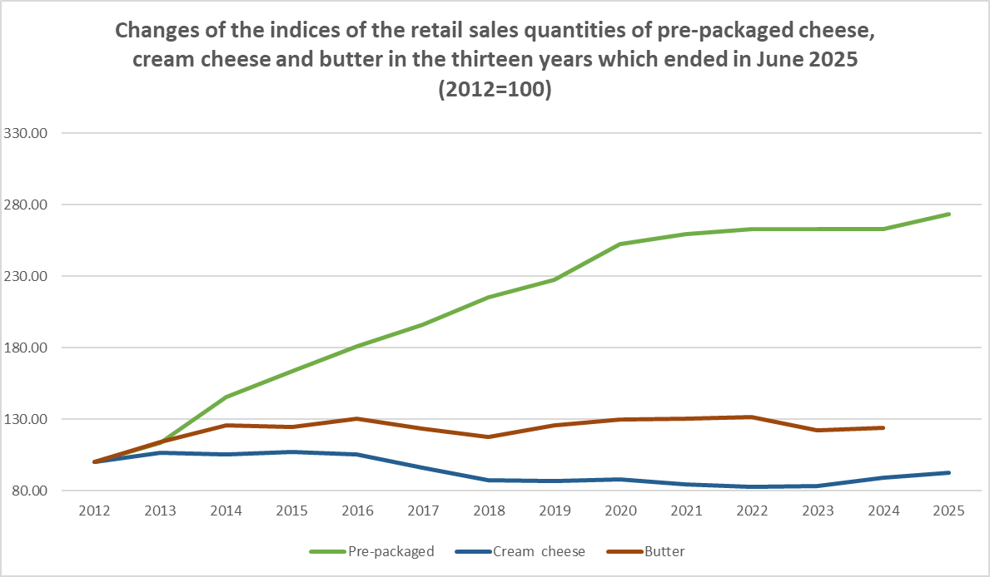
Graph 20
62
Graph prepared by the Office of SAMPRO based on information obtained from NielsenIQ

Slide 63
Graph 21
THE PRODUCER PRICE INDEX (PPI) OF UNPROCESSED MILK, FROM DECEMBER 2016 TO SEPTEMBER 2025 AND THE RETAIL PRICE INDICES (RPI) OF FRESH MILK AND UHT MILK, FROM DECEMBER 2016 TO JUNE 2025
Table 32
INCREASE IN UNPROCESSED MILK PURCHASES RELATIVE TO PREVIOUS YEAR (PERCENT)
2012 | 2013 | 2014 | 2015 | 2016 | 2017 | 2018 | 2019 | 2020 | 2021 | 2022 | 2023 | 2024
4.5 | 2.22 | 2.65 | 6.37 | -0.45 | 3.02 | 4.82 | 0.65 | -0.16 | -0.71 | -1.56 | -0.32 | 3.56
Graph prepared by the Office of SAMPRO based on information obtained from “NielsenIQ” and Statistics South Africa.
Table prepared by the Office of SAMPRO based on information obtained from Milk SA.

Slide 64
Graph 22
THE PRODUCER PRICE INDEX (PPI) OF UNPROCESSED MILK, FROM DECEMBER 2016 TO SEPTEMBER 2025 AND THE RETAIL PRICE INDICES (RPI) OF YOGHURT, MAAS AND PRE-PACKAGED CHEESE, FROM DECEMBER 2016 TO JUNE 2025
Table 33
INCREASE IN UNPROCESSED MILK PURCHASES RELATIVE TO PREVIOUS YEAR (PERCENT)
2012 | 2013 | 2014 | 2015 | 2016 | 2017 | 2018 | 2019 | 2020 | 2021 | 2022 | 2023 | 2024
4.5 | 2.22 | 2.65 | 6.37 | -0.45 | 3.02 | 4.82 | 0.65 | -0.16 | -0.71 | -1.56 | -0.32 | 3.56
Graph prepared by the Office of SAMPRO based on information obtained from “NielsenIQ” and Statistics South Africa.
Table prepared by the Office of SAMPRO based on information obtained from Milk SA.

Slide 65
Table 31
THE HIGHEST AND LOWEST DIFFERENCES RECORDED BETWEEN THE AVERAGE MONTHLY RETAIL PRICES OF UHT MILK AND FRESH MILK AND THE DIFFERENCES BETWEEN THE AVERAGE ANNUAL RETAIL PRICES OF UHT MILK AND FRESH MILK, IN THE YEARS 2012 TO 2024
YEAR | Percentage difference ⁴⁰⁾
 | Highest monthly | Lowest monthly | Average annual
2012 | 17.1 | 0.7 | 8.9
2013 | 8.9 | 2.8 | 5.9
2014 | 12.5 | 5.8 | 9.2
2015 | 11.9 | -0.7 | 5.6
2016 | 6.9 | 0.7 | 3.8
2017 | 1.8 | -2.6 | -0.4
2018 | 0.0 | -7.9 | -4.0
2019 | 3.8 | -3.8 | 0.0
2020 | 4.3 | 0.4 | 2.3
2021 | -3.8 | -2.4 | -3.1
2022 | -0.4 | -3.3 | -1.9
2023 | 2.9 | 3.6 | 3.3
2024 | 0.4 | -1.2 | -0.4
Average | 5.1 | -0.6 | 2.2
The percentages indicated are the percentages which the average retail prices of UHT milk were higher than that of fresh milk.
Table prepared by the Office of SAMPRO based on the results of surveys by “NielsenIQ”. Non-retail sales such as sales to industrial buyers are not part of the surveys.

Slide 66
SUMMARY AND CONCLUSION:
Uncertainty in the world is very high and predictability is low;
In South Africa, the uncertainty about political stability, policies, economic growth and improvement of service delivery, is very high;
Improvement of service delivery by the public sector is a prerequisite for higher economic growth;
In 2024 and 2025 (January to September), South Africa, was in terms of mass, a net exporter of 5 of the 6 types of dairy products. Lower international prices and a higher value of the Rand, can change this situation;
Future demand for consumer goods, including dairy products, is highly dependent on the level of economic growth;
Expected growth of the GDP in 2025 and 2026, higher than in 2024, but still low;
At the end of 2025, more optimism, due to factors like expected growth of the GDP, low inflation and lower interest rates;

Slide 67
In 2024, the retail sales quantities of 8 of the 9 dairy products higher than in the previous year, while in 2024, the retail sales prices of 4 of the 9 products decreased and the prices of 3 of the 9 products increased, with less than 3,0 percent;
In the year which ended in June 2025, the retail sales quantities of 6 of the 8 dairy products, were higher than in the previous year, while in the year which ended in June 2025, the retail prices of 3 of the 8 products decreased and the prices of 2 of the 8 products increased with less than 3.0 percent;
In June 2025, the retail sales quantities of 5 of the 8 dairy products, were higher than in June 2024, while the retail prices of 7 of the 8 products, were lower than in May 2025. The price decreases of 6 of the 8 products were lower than 1.0 percent;
Higher retail sales quantities achieved at the expense of price;
Amidst weak economic growth, the movements of the retail prices of dairy products and the producer price indices of dairy products and unprocessed milk, suggest slight supply side pressure.

Slide 68
The production of unprocessed milk:
  In 6 of the first 9 months of 2025, higher; and
  In 20 of the 23 months up to September 2025, higher.
The prices of maize and soybeans, which are the source of major ingredients of concentrated feed, decreased significantly.
High increase in electricity and water prices and increased fertilizer prices. Electricity and water, are also major inputs of the secondary dairy industry.
Prevention of the spread of foot and mouth disease, is important.
Future weather conditions, can significantly impact the production of unprocessed milk.
As most elements of the situation can change fairly quickly and meaningfully, the relevant variables should continuously be monitored, and changes should timeously be reacted to, in order to ensure that in South Africa, the supply of unprocessed milk and dairy products follow the demand for these products as closely possible.

Slide 69
Alwyn P Kraamwinkel (M.Com)
CEO: SAMPRO
20 November 2025
The following contributions to this presentation are acknowledged:
De Wet Jonker (B.Econ/B.Com Hons), Dr Ndumiso Mazibuko (Bsc Agric Econ, Msc, MBA, PhD) Jan Theron, (B.Com Economy), and Marietjie le Roux (B.Com Human Resources) | Collecting information, compiling of tables and graphs and assessment of information.
Gerhard Venter (M.Sc Agric Food Science) | Dairy Technical advice.
Sonja van Jaarsveldt, Anneke Roux | Assistance in preparing documents

