Slide 1

KEY MARKET SIGNALS FOR THE DAIRY INDUSTRY
(A presentation to the online General Meeting of SAMPRO by the CEO of SAMPRO
based on research reports of SAMPRO) on
23 July 2025
This presentation is available to any interested party and copies can be obtained from the Office of SAMPRO – telephone number 012 991 4164.
Enquiries regarding the content of the presentation should be directed to Alwyn P Kraamwinkel, telephone number 012 991 4164 or alwyn@sampro.co.za
South African Milk Processors’ Organisation
The voluntary organisation of milk processors for the promotion of the development of the secondary dairy industry to the benefit of the dairy industry, the consumer and the South African society.

Slide 2
Key Market signals for the Dairy Industry are about:
CONDITIONS IN THE WORLD
THE INTERNATIONAL MARKETS FOR DAIRY PRODUCTS
THE UNPROCESSED MILK MARKETS IN MAJOR DAIRY COUNTRIES
CONDITIONS IN SOUTH AFRICA
THE UNPROCESSED MILK MARKET IN SOUTH AFRICA
THE SOUTH AFRICAN MARKETS FOR DAIRY PRODUCTS

Slide 3
Conditions in the world
In 2024, uncertainty is very high due to the number and intensity of military and other conflicts, as well as changes and potential changes in 2024, of political leadership in major countries.
In the first half of 2025, the very high uncertainty increased to a record high level due to:
  Continuation of conflicts; and
  Actions and changing objectives of the USA in respect of especially:
    - Import tariffs;
    Military conflicts;
    Diplomatic relations;
    Ambition to incorporate other countries; and
    Domestic policies.

Slide 4
CONDITIONS IN THE WORLD (Continue)
Even if the conflicts stop immediately, negative consequences will, to a large extent, be a reality in the coming years.
Economic growth is undermined by record-high uncertainty.

Slide 5
World economic growth rates stated in January and April 2025 by the IMF:
  World Economies: Emerging Economies Markets and Developing Economies:
  January April January April
  3.2% 3.3% 2024 4.2% 4.3%
  3.3% 2.8% 2025 4.2% 3.7%
  3.3% 3.0% 2026 4.3% 3.9%
  Advanced Economies: China:
  January April January April
  1.7% 1.8% 2024 4.8% 5.0%
  1.9% 1.4% 2025 4.6% 4.0%
  1.8% 1.5% 2026 4.5% 4.0%

Slide 6
According to the FAO: 45 countries, of which 33 are African countries, in need of “external assistance for food”.
Downward pressure on unprocessed milk production in especially Europe, due to environmental protection measures, but growing resistance against these measures.
Increased development and promotion of plant-based alternatives for dairy and meat products.
Increase in number of studies which question the claims about the lower environmental impact of plant-based alternatives for dairy products.

Slide 7
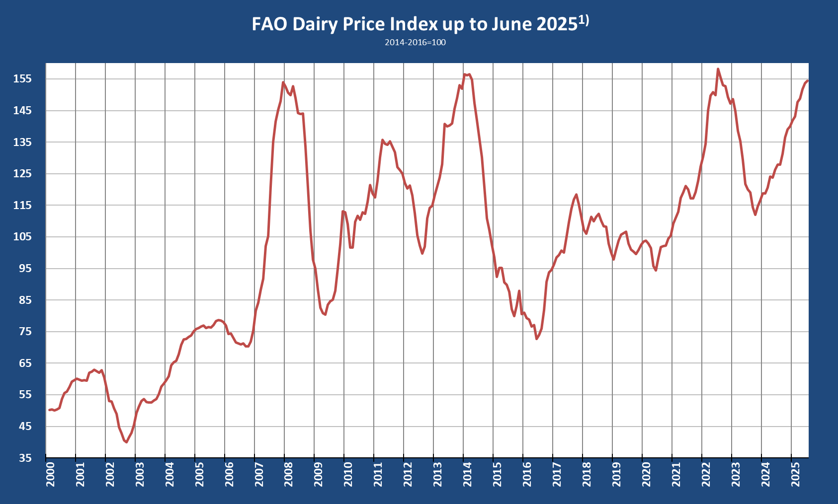
The International Markets for dairy products
Graph 1
PRICE INDEX OF DAIRY PRODUCTS TRADED INTERNATIONALY UP TO JUNE 2025
Graph as published by the Food and Agricultural Organisation (FAO) of the United Nations.

Slide 8
Table 1
VOLATILITY PER YEAR OF THE PRICE INDEX OF THE FAO OF DAIRY PRODUCTS IN THE INTERNATIONAL MARKET
Index: 2014-2016=100
YEAR | A Highest Monthly Index | B Lowest Monthly Index | A Higher than B Percent
2000 | 60.1 | 50.1 | 20.0
2001 | 62.9 | 56.9 | 10.6
2002 | 53.0 | 40.1 | 32.2
2003 | 59.7 | 51.3 | 16.5
2004 | 75.8 | 60.9 | 24.4
2005 | 78.7 | 76.2 | 3.4
2006 | 81.7 | 70.3 | 16.2
2007 | 154.0 | 84.2 | 82.8
2008 | 152.6 | 94.9 | 60.9
2009 | 113.1 | 80.4 | 40.7
2010 | 121.4 | 101.6 | 19.5
2011 | 135.8 | 122.0 | 11.3
2012 | 121.2 | 99.7 | 21.6
2013 | 156.5 | 121.0 | 29.3
2014 | 156.4 | 98.5 | 58.8
2015 | 95.2 | 79.9 | 19.0
2016 | 96.2 | 72.7 | 32.3
2017 | 118.4 | 98.6 | 20.1
2018 | 112.3 | 97.8 | 14.7
2019 | 106.6 | 99.6 | 7.0
2020 | 108.7 | 94.5 | 15.0
2021 | 130.4 | 111.1 | 17.4
2022 | 158.2 | 134.3 | 17.8
2023 | 144.7 | 112.0 | 29.3
2024 | 141.9 | 118.7 | 19.6
Average | 111.8 | 89.1 | 25.6
2025 (Jan-Jun) | 154.4 | 143.4 | 7.9
Table prepared by the Office of SAMPRO based on information published by the FAO.

Slide 9
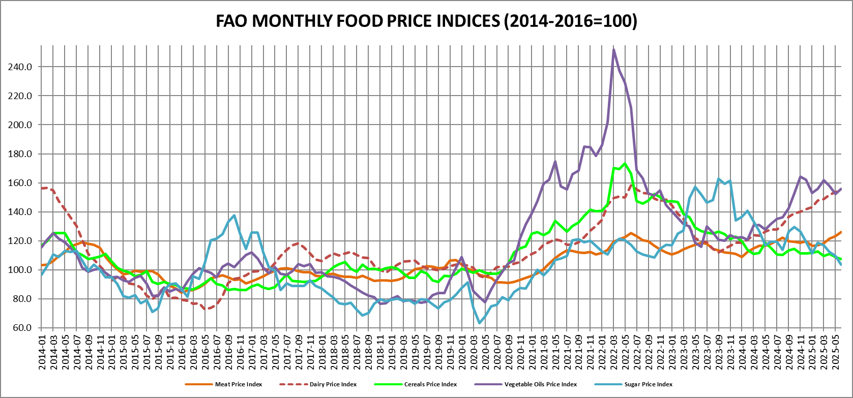
Graph 2
THE PRICE HISTORY OF DIFFERENT FOOD PRODUCTS IN THE INTERNATIONAL MARKET FROM 2014 TO JUNE 2025
Graph prepared by the Office of SAMPRO based on information published by the FAO, in the ”Global Food Price Monitor”.

Slide 10
Graph 3
Graph prepared by the Office of SAMPRO based on information published by the USDA on 5 June 2025

Slide 11
Table 2
WORLD MARKET PRICES (F.O.B.) OF SPECIFIC DAIRY PRODUCTS END MAY 2025
Product | Price $ / kg | Price R / kg (R18.08=$)
Butter | 8.20 - 8.65 | 148.26 - 156.39
Whole milk powder | 4.80 - 5.08 | 86.78 - 91.85
Skimmed milk powder | 2.68 - 2.83 | 48.45 - 51.17
Table 3
PRICES (F.O.B.) OF CERTAIN DAIRY PRODUCTS FROM OCEANIA MID MAY 2025
Product | Price $ / kg | Price R / kg (R18.08=$)
Butter | 7.45 - 8.15 | 134.70 - 147.35
Whole milk powder | 4.10 - 4.50 | 74.13 - 81.36
Skimmed milk powder | 2.83 - 3.13 | 51.17 - 56.59
Table 2 prepared by the Office of SAMPRO based on information published in the USDA Agricultural Marketing Service. The prices are free on board prices from Western Europe.
Table 3 prepared by the Office of SAMPRO based on information published in the USDA Agricultural Marketing Service. The prices are free on board prices from Oceania.

Slide 12
Graph 4
Graph prepared by the Office of SAMPRO based on information contained in the United States Department of Agriculture, Livestock, Dairy, and Poultry Outlook, 18 June 2025

Slide 13
Table 4
FUTURE PRICES IN USA$ AND RAND ($=R18.08) PER TON ACHIEVED AT GLOBAL DAIRY TRADE AUCTION ON 17 JUNE 2025, FOR DELIVERY IN JULY 2025 TO NOVEMBER 2025
 | 2025
 | Jul | Aug | Sep | Oct | Nov
Whole Milk Powder | 4 268 | 4 189 | 4 059 | 3 983 | 3 951
PRICE: $ | 77 165 | 75 737 | 73 387 | 72 013 | 71 434
PRICE: R | 100.0 | 98.1 | 95.1 | 93.3 | 92.6
Index
Skimmed Milk Powder | 2 871 | 2 761 | 2 753 | 2 826 | 2 798
PRICE: $ | 51 908 | 49 919 | 49 774 | 51 094 | 50 588
PRICE: R | 100.0 | 96.2 | 95.9 | 98.4 | 97.5
Index
Cheddar | 5 023 | 5 026 | 4 975 | 4 980 | 5 015
PRICE: $ | 90 816 | 90 870 | 89 948 | 90 038 | 90 671
PRICE: R | 100.0 | 100.1 | 99.0 | 99.1 | 99.8
Index
Butter | 8 507 | 8 334 | 8 069 | 7 305 | 7 220
PRICE: $ | 153 807 | 150 679 | 145 888 | 132 074 | 130 538
PRICE: R | 100.0 | 98.0 | 94.9 | 85.9 | 84.9
Index
Table prepared by the Office of SAMPRO based on prices as published by “Global Dairy Trade” 17 June 2025

Slide 14
Summary of conditions in the international DAIRY markets
Extremely high levels of uncertainty and predictions should be viewed with caution
FAO price index increased in the 20 months up to June 2025
Butter price on record high levels.
Future prices indicate end of upward trend.
Impact of dairy industry on environment remains a high-profile topic.
Development of substitute for dairy products attended to by many, including dairy companies.

Slide 15
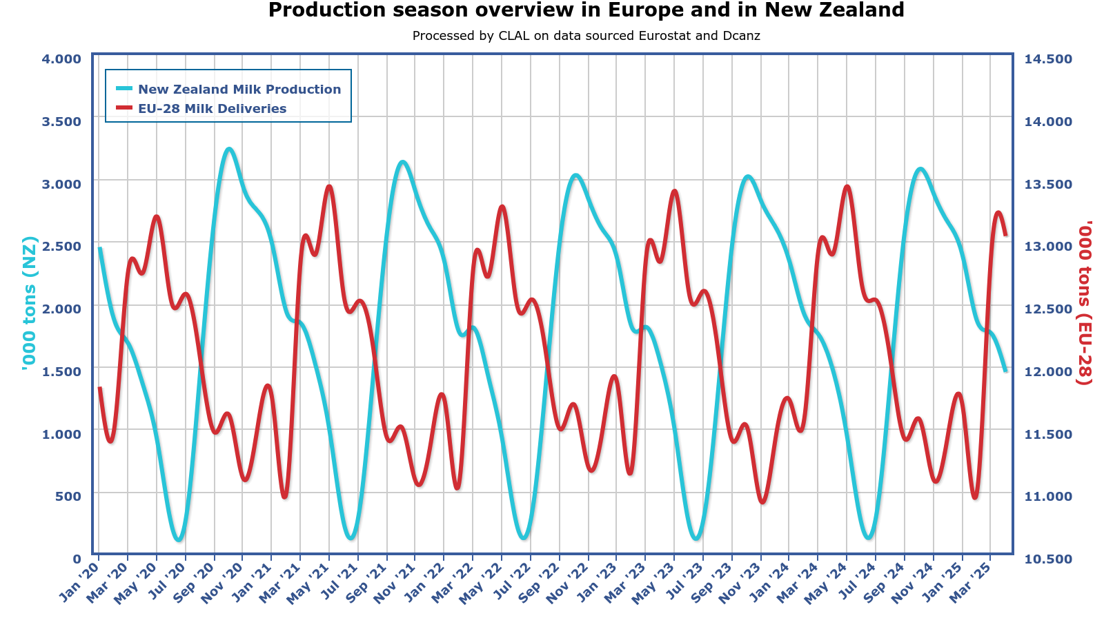
Unprocessed milk markets in major dairy countries :
Graph 5
SEASONALITY OF UNPROCESSED MILK PRODUCTION IN NORTHERN AND SOUTHERN HEMISPHERES
Graph published by CLAL.it.

Slide 16
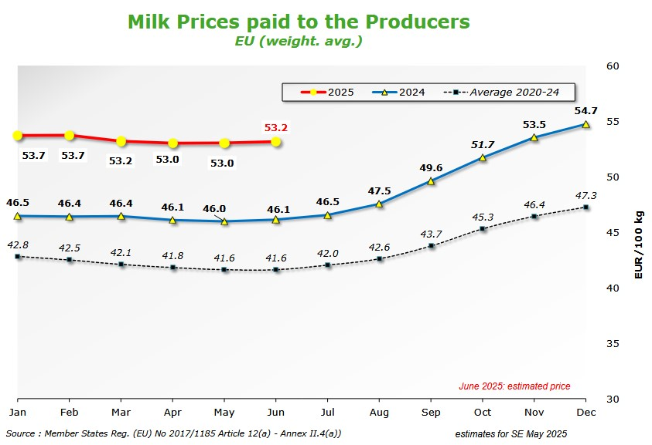
Graph 6
UNPROCESSED MILK PRICES IN THE EUROPEAN UNION
Graph published by EU Prices of Cows milk in Euro/100g. Europa.eu

Slide 17
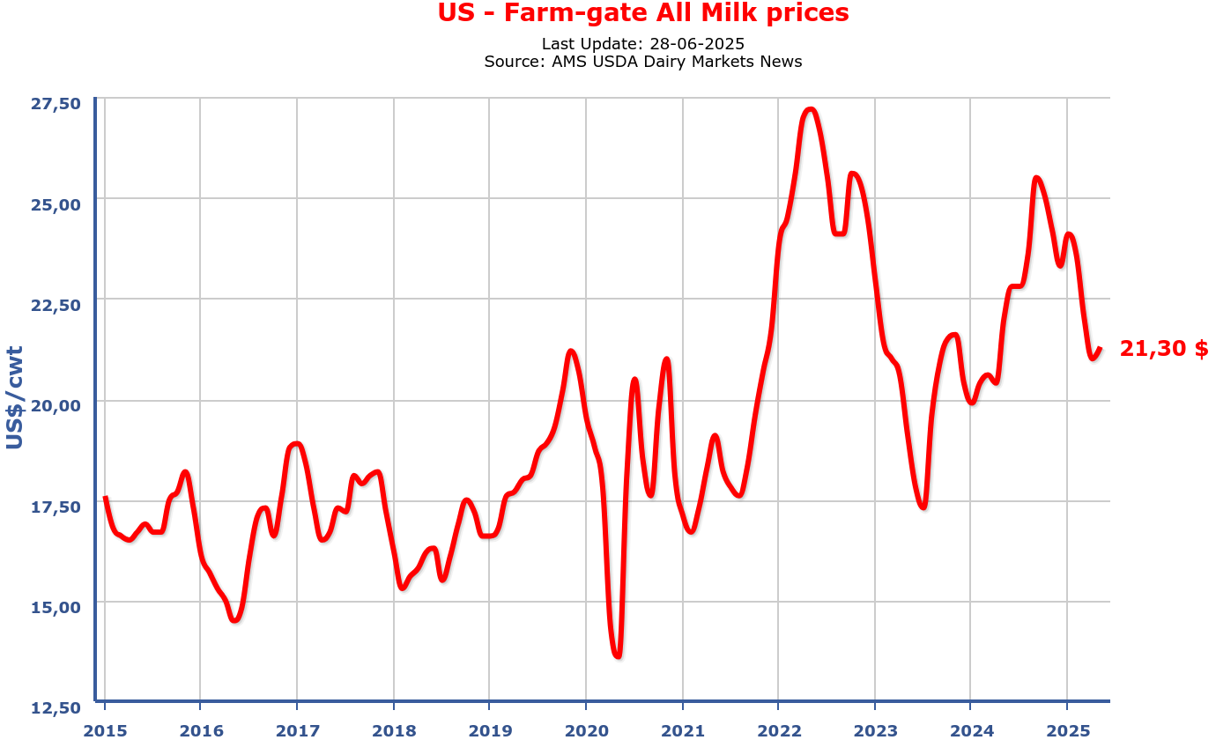
Graph 7
UNPROCESSED MILK PRICES IN THE USA
Graph published by CLAL.it.

Slide 18
Summary, unprocessed milk markets in major dairy
countries:
Prices in 2024 in the USA and in EU increased significantly.
Price in EU in 2025 January to May moved sideways at lower levels than in December 2024 but higher than in 2024 January to May.
Prices in the USA in 2025 January to May decreased.
Price in USA very volatile.
Negative sentiment in especially Europe in respect of environment impact of unprocessed milk production and animal products.
Protest by producers of unprocessed milk in EU about environmental protection measures and prices.

Slide 19
Conditions in South Africa
In 2024 optimism increased due to:
  Lack of loadshedding;
  Establishment of Government of National Unity;
  Intention of new Government to improve service delivery and to focus on inclusive growth and prevention of corruption;
  Lower inflation;
  Expected lower interest rates;

Slide 20
Conditions in South Africa
  The extremely high level of uncertainty in the world;
  Considerable weakening of diplomatic relations of South Africa with the USA and possible termination of the preferential access of particular South African products to the USA market;
  The fragile nature of the Government of National Unity;

Slide 21
Conditions in South Africa
  In the edition of “Summary of Key Market Signals of the Dairy Industry”, dated 1 April 2025, it was stated that the high optimism in 2024 about future economic growth, which was based on good reasons, was negatively influenced by events at the end of 2024 and in the first quarter of 2025.
  The validity of the statements is confirmed by the following:
  - At the beginning of 2025, the South African Reserve Bank predicted a growth rate of 1.7 percent in respect of the Gross Domestic Product (GDP) in 2025, but in May 2025, it was decreased to 1.2 percent (a reduction of 29.41 percent); and
  -At the beginning of 2025, the International Monetary Fund (IMF) predicted a growth rate of 1.5 percent in 2025, but in April 2025, it was decreased to 1.0 percent (a reduction of 33.33 percent).

Slide 22
Table 5
The GDP of South Africa at constant 2015 prices and mid-year population estimates¹⁾
 | GDP
 | R million | Index
2018 | 4 571 783 | 100.0000
2019 | 4 583 667 | 100.2599
2020 | 4 300 904 | 94.0750
2021 | 4 509 870 | 98.6458
2022 | 4 602 690 | 100.6760
2023 | 4 639 792 | 101.4876
2024 ^{2&3)} | 4 664 608 | 102.0304
2025 Estimates
IMF ⁴⁾ | 4 711 254 | 103.0507
SA Reserve Bank ⁵⁾ | 4 720 583 | 103.2547
1) Table prepared by the Office of SAMPRO based on information published by Statistics South Africa (Stats SA), the South African Reserve Bank (SARB) and the IMF. In respect of 2024, the IMF stated in January 2024 an expected growth rate of 1.0 percent, 0.9 percent in April 2024, 1.1 percent in October 2024 and 0.8 percent in January 2025. The actual growth rate in 2024 was 0,5349 percent (published on 3 June 2025 by Stats SA) In respect of 2024, the SARB stated in January 2024 an expected growth rate of 1.2 percent and in October 2024 1.1 percent. The actual growth rate in 2024 was 0,5349 percent 4) In October 2024 and again in January 2025, the IMF stated an expected growth rate of 1.5 percent in 2025 but in April 2025 the IMF changed expected growth rate to 1 percent. 5) In March 2025, the Monetary Policy Committee (MPC) of the SARB predicted a growth rate of 1.7 percent for 2025 but in May 2025 the MPC changed it to 1.2 percent.

Slide 23
Table 6
Indices of rate of unemployment⁴⁾ in South Africa (First quarter 2015 = 100)
Year | Quarter 1 | Quarter 2 | Quarter 3 | Quarter 4 | Average⁵⁾
2015 | 100.00 | 94.64 | 96.59 | 92.80 | 96.00
2016 | 101.13 | 100.75 | 102.65 | 100.37 | 101.22
2017 | 104.92 | 104.92 | 104.92 | 101.13 | 103.97
2018 | 101.13 | 103.03 | 104.16 | 102.65 | 102.74
2019 | 104.54 | 109.84 | 110.22 | 110.22 | 108.70
2020 | 114.01 | 88.25 | 116.66 | 123.10 | 110.50
2021 | 123.48 | 130.30 | 132.19 | 133.71 | 129.92
2022 | 130.68 | 128.40 | 124.62 | 123.86 | 126.89
2023 | 124.62 | 123.48 | 120.83 | 121.54 | 122.63
2024 | 124.62 | 126.89 | 121.59 | 120.83 | 123.49
2025 | 124.62
4) Table prepared by the Office of SAMPRO based on information published by Statistics South Africa in its STATISTICAL RELEASE P0211 titled “Quarterly Labour Force Survey Quarter 1 2025” and previous editions of PO211. 5) Average calculated by the Office of SAMPRO by dividing the sum of the quarterly figures of the year by four.

Slide 24
The truth that economic growth, lower unemployment and transformation are dependent on improvement of the competitiveness (productivity) of the public and private sectors, does not receive enough attention in the determination of government policies and measures and in public debates.

Slide 25
The unprocessed milk market in South Africa
Table 7
TOTAL QUANTITY OF UNPROCESSED MILK PURCHASED IN SOUTH AFRICA DURING THE
YEARS 2008 TO 2024
YEAR | UNPROCESSED MILK KILOGRAM | PERCENTAGE CHANGE FROM PREVIOUS YEAR | INDEX 2008 = 100
2008 | 2 624 511 678 | 2.50 | 100.00
2009 | 2 586 868 067 | -1.43 | 98.57
2010 | 2 711 236 032 | 4.81 | 103.30
2011 | 2 720 402 147 | 0.34 | 103.65
2012 | 2 842 810 159 | 4.50 | 108.32
2013 | 2 905 811 947 | 2.22 | 110.72
2014 | 2 982 734 569 | 2.65 | 113.65
2015 | 3 172 655 770 | 6.37 | 120.89
2016 | 3 158 466 390 | -0.45 | 120.34
2017 | 3 253 682 081 | 3.02 | 123.97
2018 | 3 410 535 904 | 4.82 | 129.95
2019 | 3 432 802 396 | 0.65 | 130.80
2020 | 3 427 335 378 | -0.16 | 130.56
2021 | 3 403 100 413 | -0.71 | 129.67
2022 | 3 349 861 004 | -1.56 | 127.64
2023 | 3 339 272 379 | -0.32 | 127.23
2024 | 3 458 059 966 | 3.56 | 131.76
Table prepared by the Office of SAMPRO based on information obtained from Milk SA

Slide 26
Table 9
AVERAGE AGGREGATE COMPOUND GROWTH RATE PER YEAR OF THE MASS OF PRODUCTION OF
UNPROCESSED MILK IN SOUTH AFRICA
Years | Average aggregate compound growth rate per year Percent
2008 to 2011 (3 years) | 1.20
2011 to 2014 (3 years) | 3.12
2014 to 2017 (3 years) | 2.94
2017 to 2020 (3 years) | 1.75
2020 to 2023 (3 years) | -0.86
2008 to 2023 (15 years) | 1.52
Table prepared by the Office of SAMPRO based on information obtained from Milk SA.

Slide 27
Table 10
DIFFERENCE BETWEEN THE HIGHEST AND LOWEST MASS OF PRODUCTION OF UNPROCESSED MILK PER DAY IN SOUTH AFRICA, IN THE YEARS 2009 TO 2024
Year | Percent
2009 | 35.3
2010 | 32.2
2011 | 32.0
2012 | 29.0
2013 | 29.9
2014 | 37.7
2015 | 25.2
2016 | 32.9
2017 | 39.5
2018 | 35.3
2019 | 35.3
2020 | 36.3
2021 | 40.9
2022 | 39.9
2023 | 40.7
2024 | 41,3
Average 2009 to 2024 | 35.2
Table prepared by the Office of SAMPRO based on information obtained from Milk SA.

Slide 28
Graph 8
Graph prepared by the Office of SAMPRO based on information obtained from MILK SA. The information in respect of 2019 to May 2025, is in respect of the total unprocessed milk purchased by all registered unprocessed milk buyers, declared in terms of Regulation 1652 of the Marketing of Agricultural Products Act and previous similar regulations. The figures for April and May 2025, are estimated figures determined on the assumption that the market share of the sample in the total unprocessed milk purchased is 89.44 percent, as was the case in the three-month period, January to March 2025.

Slide 29
Table 11
MASS OF UNPROCESSED MILK PURCHASES IN PARTICULAR MONTHS, RELATIVE TO THE PURCHASES IN THE SAME MONTHS OF PARTICULAR PREVIOUS YEARS
 | Percentage increase
September 2022 relative to September 2021 | -0.3
October 2022 relative to October 2021 | -2.5
November 2022 relative to November 2021 | -5.1
December 2022 relative to December 2021 | -5.9
January 2023 relative to January 2022 | -3.2
February 2023 relative to February 2022 | -1.5
March 2023 relative to March 2022 | -0.7
April 2023 relative to April 2022 | 0.7
May 2023 relative to May 2022 | -1.1
June 2023 relative to June 2022 | -0.6
July 2023 relative to July 2022 | -2.2
August 2023 relative to August 2022 | -0.6
September 2023 relative to September 2022 | 0.1
October 2023 relative to October 2022 | -0.1
November 2023 relative to November 2022 | 1.8
December 2023 relative to December 2022 | 2.8
January 2024 relative to January 2023 | 2.6
February 2024 relative to February 2023 | 1.5
March 2024 relative to March 2023 | 1.4
April 2024 relative to April 2023 | 2.2
May 2024 relative to May 2023 | 6.7
June 2024 relative to June 2023 | 3.4
July 2024 relative to July 2023 | 3.7
August 2024 relative to August 2023 | 2.0
September 2024 relative to September 2023 | 2.4
October 2024 relative to October 2023 | 3.9
November 2024 relative to November 2023 | 5.4
December 2024 relative to December 2023 | 4.2
January 2025 relative to January 2024 | 1.9
February 2025 relative to February 2024 | 0.7
March 2025 relative to March 2024 | 2.0
April 2025 relative to April 2024 (est) | -1.0
May 2025 relative to May 2024 (est) | -3.7
Table prepared by the Office of SAMPRO based on information obtained from Milk SA and the figures for April and May 2025 are estimates.

Slide 30
Table 12
UNPROCESSED MILK PURCHASES PER QUARTER OF EACH OF THE YEARS 2009 TO FIRST QUARTER OF 2025
UNPROCESSED MILK PURCHASES PER QUARTER OF EACH OF THE YEARS 2009 to 2025
Year | Quarter 1 |  |  | Quarter 2 |  | Quarter 3 |  |  | Quarter 4 |  |  | Total
 | Kg |  | % | Kg | % | Kg |  | % | Kg |  | % | Kg | %
2009 | 620 043 005 |  | 23.969 | 560 531 455 | 21.668 | 658 577 140 |  | 25.458 | 747 716 467 |  | 28.904 | 2 586 868 067 | 100
2010 | 640 933 409 |  | 23.640 | 595 998 091 | 21.983 | 699 002 502 |  | 25.782 | 775 302 030 |  | 28.596 | 2 711 236 032 | 100
2011 | 654 701 438 |  | 24.066 | 597 343 799 | 21.958 | 694 671 935 |  | 25.536 | 773 684 975 |  | 28.440 | 2 720 402 147 | 100
2012 | 676 129 726 |  | 23.784 | 638 011 059 | 22.443 | 725 458 007 |  | 25.519 | 803 211 367 |  | 28.254 | 2 842 810 159 | 100
2013 | 683 707 219 |  | 23.529 | 646 811 485 | 22.259 | 746 796 407 |  | 25.700 | 828 496 836 |  | 28.512 | 2 905 811 947 | 100
Total (2009-2013) | 3 275 514 797 |  | 23.792 | 3 038 695 889 | 22.072 | 3 524 505 991 |  | 25.601 | 3 928 411 675 |  | 28.535 | 13 767 128 352 | 100
Year | Quarter 1 |  |  | Quarter 2 |  | Quarter 3 |  |  | Quarter 4 |  |  | Total
 | Kg |  | % | Kg | % | Kg |  | % | Kg |  | % | Kg | %
2014 | 683 060 914 |  | 22.900 | 650 998 523 | 21.826 | 766 083 031 |  | 25.684 | 882 592 129 |  | 29.590 | 2 982 734 597 | 100
2015 | 770 769 019 |  | 24.294 | 726 975 249 | 22.914 | 799 968 233 |  | 25.214 | 874 943 269 |  | 27.578 | 3 172 655 770 | 100
2016 | 743 935 710 |  | 23.816 | 701 859 008 | 22.222 | 806 386 965 |  | 25.531 | 897 973 819 |  | 28.431 | 3 150 155 502 | 100
2017 | 756 689 792 |  | 23.256 | 703 893 532 | 21.634 | 837 867 145 |  | 25.751 | 955 231 612 |  | 29.358 | 3 253 682 081 | 100
2018 | 814 831 903 |  | 23.892 | 750 437 490 | 22.004 | 873 519 325 |  | 25.612 | 971 747 186 |  | 28.493 | 3 410 535 904 | 100
Total (2014-2018) | 3 769 287 338 |  | 23.630 | 3 534 163 802 | 22.130 | 4 083 824 699 |  | 25.572 | 4 582 488 015 |  | 28.695 | 15 969 763 854 | 100
Year | Quarter 1 |  |  | Quarter 2 |  | Quarter 3 |  |  | Quarter 4 |  |  | Total
 | Kg |  | % | Kg | % | Kg |  | % | Kg |  | % | Kg | %
2019 | 816 208 186 |  | 23.777 | 757 906 127 | 22.078 | 882 584 853 |  | 25.710 | 976 103 230 |  | 28.435 | 3 432 802 396 | 100
2020 | 831 232 775 |  | 24.253 | 744 621 901 | 21.726 | 874 078 494 |  | 25.503 | 977 402 208 |  | 28.518 | 3 427 335 378 | 100
2021 | 791 682 285 |  | 23.264 | 739 610 710 | 21.733 | 874 291 459 |  | 25.691 | 997 515 959 |  | 29.312 | 3 403 100 413 | 100
2022 | 792 616 775 |  | 23.661 | 724 752 937 | 21.635 | 879 548 171 |  | 26.256 | 952 943 120 |  | 28.448 | 3 349 861 004 | 100
2023 | 777 738 787 |  | 23.291 | 722 335 713 | 21.632 | 872 561 910 |  | 26.130 | 966 635 969 |  | 28.948 | 3 339 272 379 | 100
Total (2019-2023) | 4 009 578 807 |  | 23.651 | 3 689 227 388 | 21.762 | 4 383 064 887 |  | 25.855 | 4 870 600 486 |  | 28.731 | 16 952 371 569 | 100
Total (2009-2023) | 11 054 280 942 |  | 23.676 | 10 262 087 079 | 21.980 | 11 991 395 576 |  | 25.683 | 13 381 500 176 |  | 28.661 | 46 689 263 773 | 100
2024 | 800 881 701 |  | 23.160 | 751 811 286 | 21.741 | 895 542 213 |  | 25.897 | 1 009 824 767 |  | 29.202 | 3 458 059 966 | 100
2025 | 813 502 961
Table prepared by the Office of SAMPRO based on information obtained from Milk SA.

Slide 31
Table 13
DECREASE IN THE MONTHLY UNPROCESSED MILK PURCHASES IN SOUTH AFRICA, FROM OCTOBER TO DECEMBER, OCTOBER TO FEBRUARY, OCTOBER TO APRIL AND OCTOBER TO JUNE, IN THE YEARS 2008 TO 2024
Year | October to December percent | October to February percent | October to April percent | October to June percent
2008/9 | 5.5 | 16.9 | 24.4 | 25.4
2009/10 | 3.9 | 14.6 | 20.4 | 21.2
2010/11 | 5.0 | 15.6 | 23.4 | 23.7
2011/12 | 5.6 | 14.5 | 19.5 | 18.2
2012/13 | 6.6 | 14.9 | 20.9 | 20.5
2013/14 | 5.3 | 18.0 | 22.9 | 21.8
2014/15 | 4.2 | 12.9 | 17.1 | 19.4
2015/16 | 7.7 | 15.9 | 20.5 | 22.0
2016/17 | 7.9 | 17.8 | 22.2 | 24.9
2017/18 | 4.0 | 13.8 | 18.7 | 23.3
2018/19 | 5.7 | 16.8 | 21.9 | 25.6
2019/20 | 7.3 | 17.4 | 24.4 | 26.2
2020/21 | 7.8 | 21.2 | 24.2 | 27.7
2021/22 | 8.2 | 23.0 | 27.6 | 30.3
2022/23 | 11.5 | 22.2 | 25.2 | 29.0
2023/24 | 9.0 | 20.8 | 23.7 | 27.0
2024/25 | 8.7 | 20.6 | 27.1
Average 2008/9 to 2024/25 | 6.7 | 17.5 | 22.6 | 24.2
Table prepared by the Office of SAMPRO on the basis of information obtained from MILK SA. The information in respect of 2008 to 2024, is in respect of the total unprocessed milk purchased by all registered milk buyers declared in terms of Regulation 1652 of the Marketing of Agricultural Products Act and previous similar regulations

Slide 32
Table 14
INCREASE IN THE MASS OF MONTHLY UNPROCESSED MILK PURCHASES IN SOUTH AFRICA, FROM
JULY TO AUGUST, JULY TO SEPTEMBER AND JULY TO OCTOBER IN EACH OF THE YEARS 2008 TO 2024
Year | July to August Percent | July to September Percent | July to October Percent
2008 | 10.8 | 22.2 | 24.6
2009 | 12.4 | 24.5 | 29.3
2010 | 9.7 | 19.8 | 24.2
2011 | 10.6 | 26.3 | 28.2
2012 | 10.3 | 21.8 | 25.6
2013 | 11.4 | 23.0 | 26.4
2014 | 13.0 | 27.2 | 32.9
2015 | 10.6 | 20.7 | 25.1
2016 | 12.9 | 27.3 | 30.8
2017 | 15.7 | 28.7 | 32.0
2018 | 13.6 | 24.7 | 29.0
2019 | 16.0 | 28.1 | 30.8
2020 | 14.5 | 27.2 | 31.9
2021 | 15.1 | 30.1 | 35.8
2022 | 16.8 | 29.3 | 31.9
2023 | 18.9 | 32.4 | 34.9
2024 | 16.9 | 32.9 | 35.0
Average 2008 to 2024 | 13.5 | 26.2 | 30.0
Table prepared by the Office of SAMPRO on the basis of information obtained from MILK SA. The information in respect of 2008 to 2023, is in respect of the total unprocessed milk purchased by all registered milk buyers declared in terms of Regulation 1652 of the Marketing of Agricultural Products Act and previous similar regulations.

Slide 33
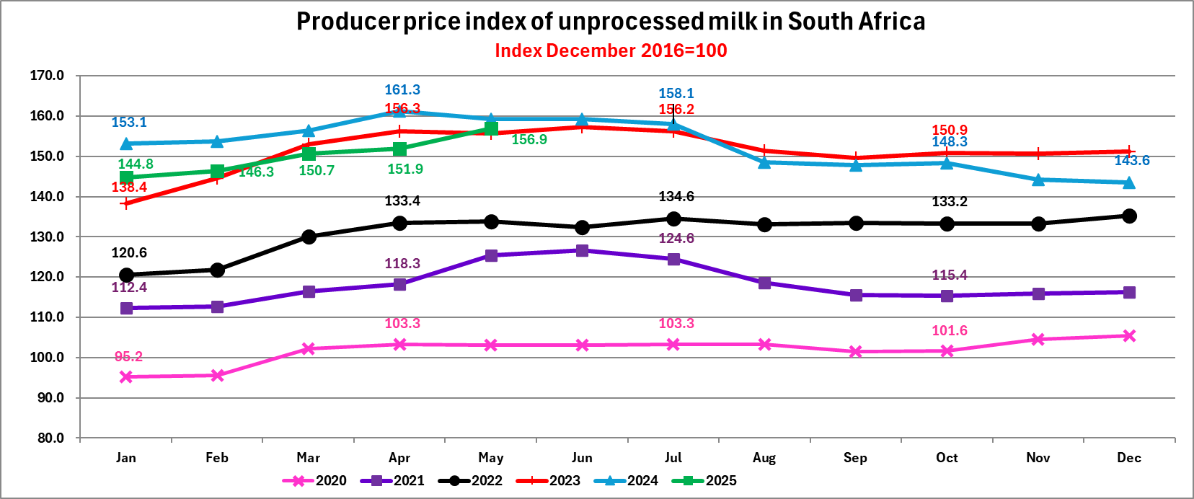
Graph 9
Graph prepared by the Office of SAMPRO and is based on the information as published by Statistics SA.

Slide 34
Table 15
MONTHLY INCREASE IN THE PRODUCER PRICE INDEX OF UNPROCESSED MILK
Index: Dec 2016=100
Percentage increase
September 2022 relative to August 2022 | 0.30
October 2022 relative to September 2022 | -0.22
November 2022 relative to October 2022 | 0.00
December 2022 relative to November 2022 | 1.58
January 2023 relative to December 2022 | 2.29
February 2023 relative to January 2023 | 4.48
March 2023 relative to February 2023 | 5.81
April 2023 relative to March 2023 | 2.16
May 2023 relative to April 2023 | -0.38
June 2023 relative to May 2023 | 1.09
July 2023 relative to June 2023 | -0.76
August 2023 relative to July 2023 | -3.01
September 2023 relative to August 2023 | -1.25
October 2023 relative to September 2023 | 0.87
November 2023 relative to October 2023 | -0.20
December 2023 relative to November 2023 | 0.33
January 2024 relative to December 2023 | 1.32
February 2024 relative to January 2024 | 0.39
March 2024 relative to February 2024 | 1.76
April 2024 relative to March 2024 | 3.13
May 2024 relative to April 2024 | -1.24
June 2024 relative to May 2024 | 0.00
July 2024 relative to June 2024 | -0.75
August 2024 relative to July 2024 | -6.01
September 2024 relative to August 2024 | -0.54
October 2024 relative to September 2024 | 0.34
November 2024 relative to October 2024 | -2.76
December 2024 relative to November 2024 | -0.42
January 2025 relative to December 2024 | 0.84
February 2025 relative to January 2025 | 1.04
March 2025 relative to February 2025 | 3.00
April 2025 relative to March 2025 | 0.80
May 2025 relative to April 2025 | 3.29
Table prepared by the Office of SAMPRO based on information published by Statistics SA.

Slide 35
Table 16
THE DIFFERENCE BETWEEN THE HIGHEST AND LOWEST PRODUCER PRICE INDEX OF UNPROCESSED MILK IN SOUTH AFRICA IN EACH OF THE YEARS 2015 TO 2024
Index: Dec 2016=100
Year | Percent
2015 (Highest in May and June, Lowest in December) | 18.2
2016 (Highest in October, Lowest in January) | 22.5
2017 (Highest in October and November, Lowest in February) | 6.5
2018 (Highest in March, Lowest in December) | 18.1
2019 (Highest in April, Lowest in January) | 12.0
2020 (Highest in December, Lowest in January) | 10.7
2021 (Highest in June, Lowest in January) | 12.8
2022 (Highest in December, Lowest in January) | 12.2
2023 (Highest in June, Lowest in January) | 13.7
2024 (Highest in April, Lowest in December) | 12.3
Average | 13.9
Table prepared by the Office of SAMPRO based on information published by Statistics SA.

Slide 36
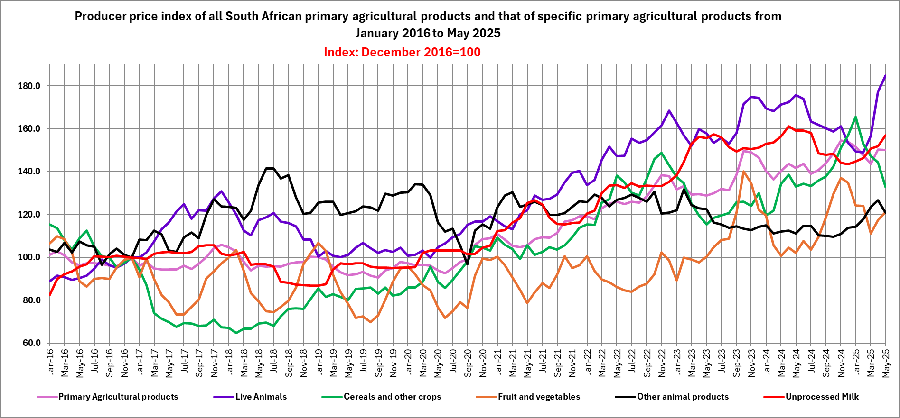
Graph 10
Graph prepared by the Office of SAMPRO and is based on the information as published by Statistics SA.

Slide 37
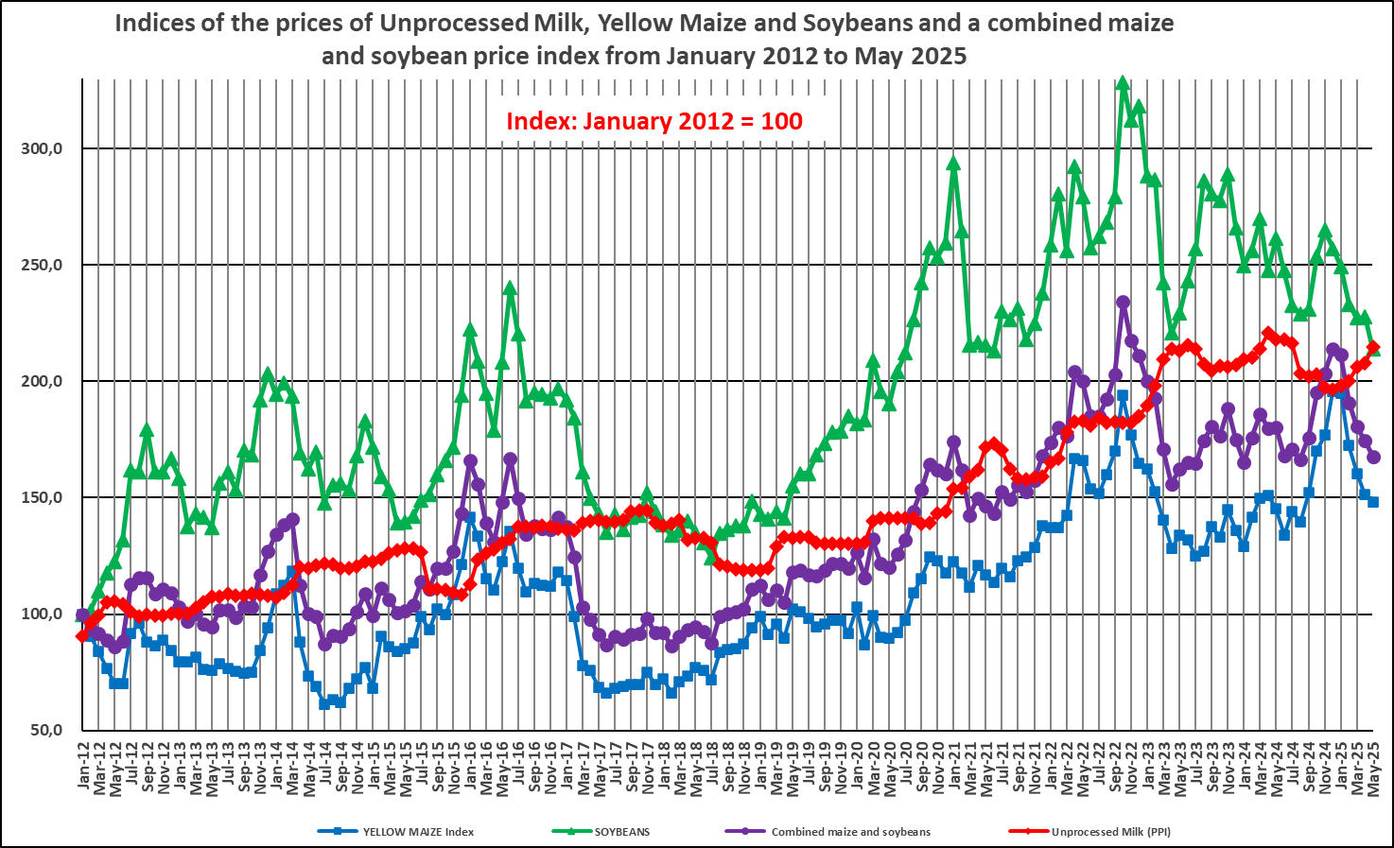
Graph 11
INCREASE IN UNPROCESSED MILK PURCHASES RELATIVE TO PREVIOUS YEAR (PERCENT)²³⁾
2012 | 2013 | 2014 | 2015 | 2016 | 2017 | 2018 | 2019 | 2020 | 2021 | 2022 | 2023 | 2024
4.5 | 2.22 | 2.65 | 6.37 | -0.45 | 3.02 | 4.82 | 0.65 | -0.16 | -0.71 | -1.56 | -0.32 | 3.56
23) The combined maize and soya price index is an index of prices equal to 70 percent of the maize price, plus 30 percent of the soya price.
Graph prepared by the Office of SAMPRO based on information obtained from Statistics SA, SAFEX middle of the month prices and unprocessed milk purchases from Milk SA.

Slide 38
Table 17
FUTURE PRICES OF YELLOW MAIZE IN SOUTH AFRICA (R/TON) ON 29 APRIL 2025 AND
20 JUNE 2025, ACCORDING TO GRAIN SA
 | A CLOSING BID 29 April 2025 R/Ton | B CLOSING BID 20 June 2025 R/Ton | C Percentage change from A to B
^{June 2025} | ⁴ ³⁰⁷ | ⁴ ²²⁵ | ^{-1.9}
^{July 2025} | ⁴ ²⁶⁹ | ⁴ ²⁵⁹ | ^{-0.2}
^{September 2025} | ⁴ ³⁵⁶ | ⁴ ³⁴⁹ | ^{-0.2}
^{December 2025} | ⁴ ⁴³⁶ | ⁴ ⁴⁴⁰ | ^{0.1}
^{March 2026} | ⁴ ⁴⁴⁰ | ⁴ ³⁹⁷ | ^{-1.0}
Table prepared by the Office of SAMPRO based on information as obtained from the GRAIN SA website

Slide 39
Table 18
FUTURE PRICES OF SOYBEANS IN SOUTH AFRICA (R/TON) ON 29 APRIL 2025 AND
20 JUNE 2025, ACCORDING TO SAFEX
 | A CLOSING BID 29 April 2025 R/Ton | B CLOSING BID 20 June 2025 R/Ton | C Percentage change from A to B
^{June 2025} | ⁷ ⁸⁸¹ | ⁷ ³⁷⁵ | ^{-6.4}
^{July 2025} | ⁷ ⁸⁰⁵ | ⁷ ⁴⁰⁰ | ^{-5.2}
^{September 2025} | ⁷ ⁹⁵⁰ | ⁷ ⁵⁴⁴ | ^{-5.1}
^{December 2025} | ⁸ ¹⁸⁰ | ⁷ ⁷⁴⁰ | ^{-5.4}
^{March 2026} | ⁸ ⁰⁵⁰ | ⁷ ⁷⁸⁸ | ^{-3.3}
Table prepared by the Office of SAMPRO based on information as obtained from the GRAIN SA website

Slide 40
Table 19
FERTILIZER PRICES IN SOUTH AFRICA
^{Fertilizer} | ^{April 2024} ^{Rand / Ton} | ^{April 2025} ^{Rand / Ton} | Percentage change from April 2024 to April 2025
^{LAN (28)} | ⁹ ⁸⁹⁰ | ⁸ ³⁶¹ | ^{-15.4}
^{Urea (46)} | ¹⁰ ⁵³² | ¹⁰ ⁸⁵⁴ | ^{3.0}
^{MAP} | ¹⁵ ⁹¹⁸ | ¹⁵ ⁹¹² | ^{-0.04}
^{KCL} | ¹⁰ ⁵⁰¹ | ⁹ ³⁷⁸ | ^{-10.7}
Table prepared by the Office of SAMPRO based on information published by Grain SA

Slide 41
Table 20
FERTILIZER PRICES IN SOUTH AFRICA
^{Fertilizer} | ^{March 2025} ^{Rand / Ton} | ^{April 2025} ^{Rand / Ton} | Percentage change from March 2025 to April 2025
^{LAN (28)} | ⁹ ⁹⁰⁰ | ⁸ ³⁶¹ | ^{-15.6}
^{Urea (46)} | ¹¹ ⁷⁷⁰ | ¹⁰ ⁸⁵⁴ | ^{-7.8}
^{MAP} | ¹⁶ ³²⁸ | ¹⁵ ⁹¹² | ^{-2.6}
^{KCL} | ⁹ ¹³⁰ | ⁹ ³⁷⁸ | ^{2.7}
Table prepared by the Office of SAMPRO based on information published by Grain SA

Slide 42
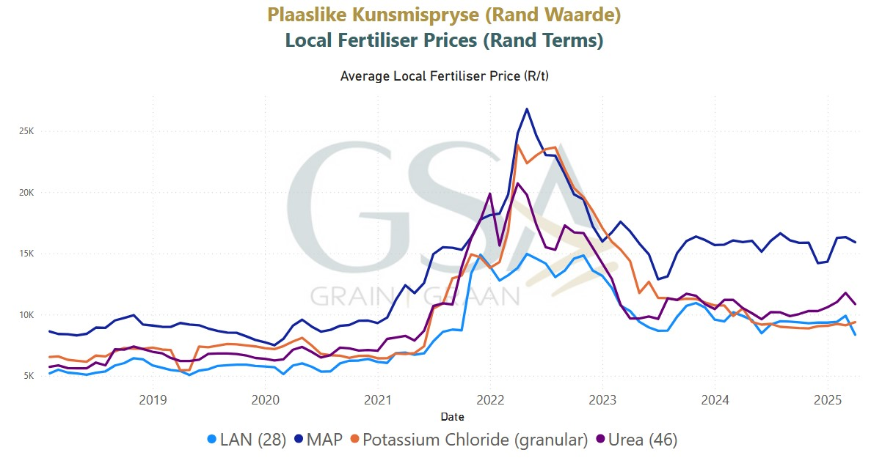
Graph 12
Graph as published by Grain SA

Slide 43
Table 21
INCREASE IN THE PRODUCER PRICE INDICES OF UNPROCESSED MILK AND DAIRY PRODUCTS
INDEX 2016 = 100
 | Unprocessed milk Percentage increase | Dairy Products Percentage increase
April to May 2025 | 3.3 | -1.3
February to May 2025 (3-month period) | 7.2 | -1.6
November 2024 to May 2025 (6-month period) | 8.8 | 0.3
May 2024 to May 2025 (12-month period) | -1.5 | -0.1
May 2023 to May 2025 (24-month period) | 0.8 | 3.6
May 2022 to May 2025 (36-month period) | 17.2 | 16.5
May 2021 to May 2025 (48-month period) | 25.1 | 26.9
January 2012 to May 2025 (160-month period) | 137.0 | 115.4
The producer price index of dairy products reflects the changes of the producer prices of pasteurised and UHT milk, yoghurt, cheddar cheese and ice cream and not that of the other dairy products like maas, cheese other than cheddar cheese and milk powder.
Table prepared by the Office of SAMPRO based on information published by Statistics SA.

Slide 44
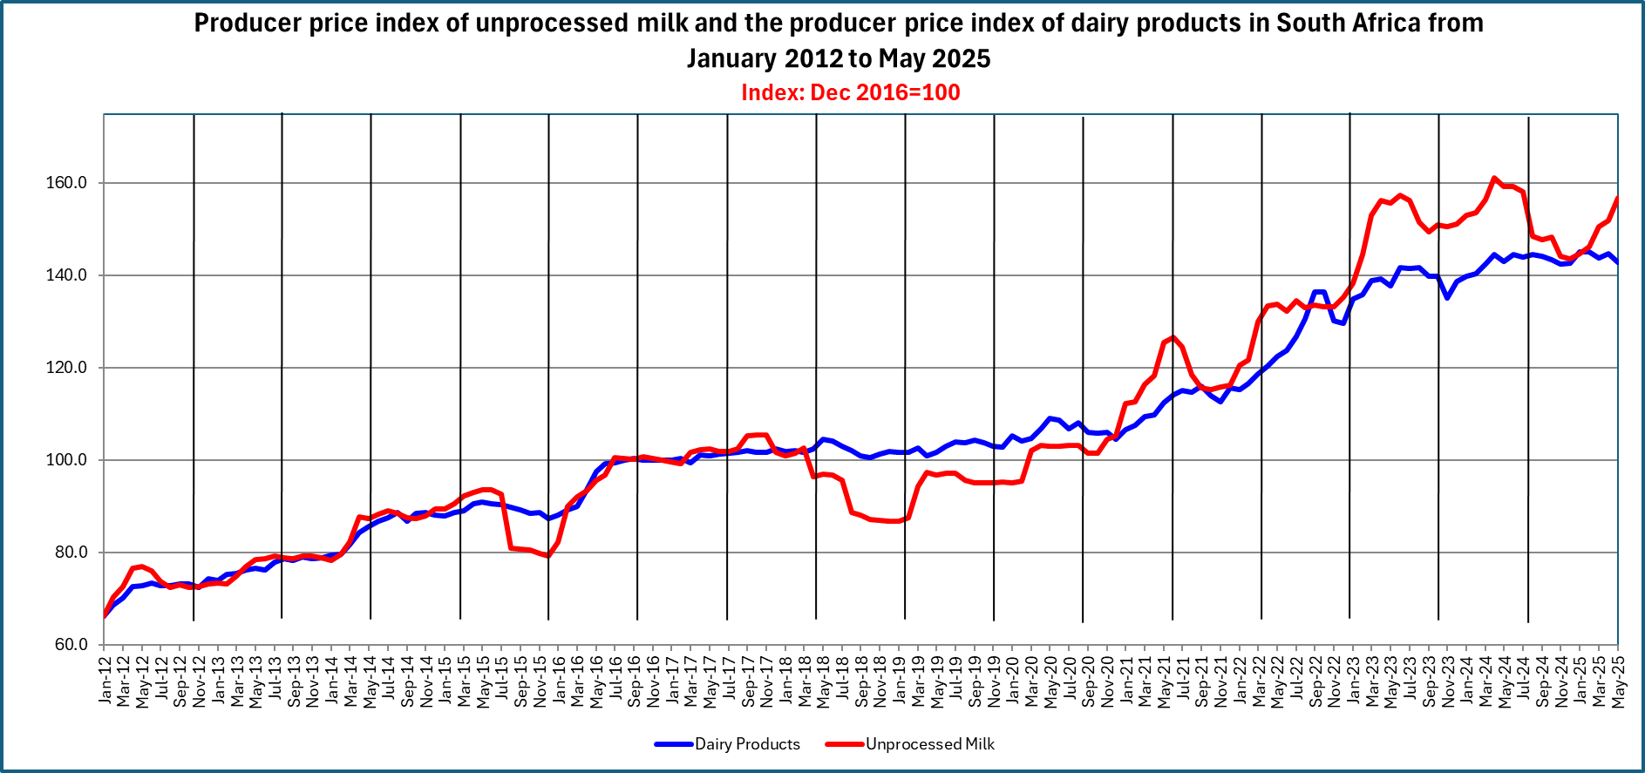
Graph 13
Graph prepared by the Office of SAMPRO based on information published by Statistics SA

Slide 45
Summary of unprocessed milk market in sa
Production of unprocessed milk
  Decreased in the 4 years (2020 – 2023);
  In 2023 lower than in previous 5 years (2018 – 2022);
  In 2024 higher than production in each of the previous 16 years; and
  Seasonal increase July 2024 to October 2024 of 35.0% higher than the average of 30.0% in the 17 years (2008 to 2024) and the second highest in the 17 years (2008 to 2023).
Favourable relationship between producer price index of unprocessed milk and the index of the combined yellow maize and soybeans disappeared at the end of 2024 but appeared again in 2025.

Slide 46
Prevention of the spread of Foot and Mouth Disease of critical importance.
Uncertainty about future weather conditions and the impact of it on the production of unprocessed milk.
Future demand for unprocessed milk will be determined by future sales of dairy products.
Next: South African markets for dairy products

Slide 47
South African markets for dairy products
Table 22
MASS OF IMPORT IN 2021, 2022, 2023, 2024 AND 2025 (Est)
Product | A 2021 ton | B 2022 ton | C 2023 Ton | D 2024 Ton | E 2025 (Est) Ton
(04.01) Milk and cream | 22 918 | 3 965 | 5 760 | 329 | 153
(04.02) Concentrated milk | 19 393 | 15 988 | 18 881 | 12 174 | 10 369
(04.03) Buttermilk and yoghurt | 3 362 | 3 387 | 4 041 | 4 745 | 4 714
(04.04) Whey | 17 056 | 18 436 | 11 589 | 10 995 | 7 153
(04.05) Butter | 4 419 | 3 602 | 1 527 | 1 237 | 290
(04.06) Cheese | 8 471 | 7 540 | 6 670 | 4 429 | 2 952
Table prepared by the Office of SAMPRO based on information published by SARS and estimated figures calculated by the Office of SAMPRO.

Slide 48
Table 23
MASS OF EXPORT IN 2021, 2022, 2023, 2024 AND 2025 (Est)
Product | A 2021 ton | B 2022 ton | C 2023 Ton | D 2024 Ton | E 2025 (Est) Ton
(04.01) Milk and cream | 24 062 | 21 544 | 23 039 | 20 166 | 19 709
(04.02) Concentrated milk | 7 528 | 10 422 | 10 844 | 11 736 | 14 166
(04.03) Buttermilk and yoghurt | 10 325 | 10 472 | 11 669 | 9 726 | 9 195
(04.04) Whey | 1 920 | 1 931 | 1 811 | 1 752 | 1 762
(04.05) Butter | 1 298 | 1 226 | 1 049 | 1 395 | 1 874
(04.06) Cheese | 5 857 | 6 349 | 7 662 | 8 773 | 11 731
Table prepared by the Office of SAMPRO based on information published by SARS and estimated figures calculated by the Office of SAMPRO.

Slide 49
Table 24
AVERAGE IMPORT AND EXPORT PRICES (F.O.B.) OF THE DIFFERENT TYPES OF DAIRY PRODUCTS, BY SOUTH AFRICA, IN 2024 AND 2025 (January to March)
PRODUCT | Import Price (f.o.b.) R/kg |  | Export Price (f.o.b.) R/kg
 | 2024 | 2025 (Jan to Mar) | 2024 | 2025 (Jan to Mar)
(04.01) Milk and Cream | 48.22 | 54.36 | 18.42 | 18.70
(04.02) Concentrated Milk | 55.25 | 58.56 | 66.69 | 62.64
(04.03) Buttermilk and Yoghurt | 43.81 | 48.14 | 29.27 | 30.16
(04.04) Whey | 34.42 | 38.53 | 24.25 | 22.79
(04.05) Butter and Oils | 115.25 | 172.31 | 96.97 | 105.96
(04.06) Cheese | 129.17 | 140.32 | 78.31 | 80.35
Table prepared by the Office of SAMPRO based on information published by SARS

Slide 50
Table 25
TOTAL IMPORT AND EXPORT OF DAIRY PRODUCTS BY SOUTH AFRICA AND THE EXPOSURE OF THE SOUTH AFRICAN DAIRY INDUSTRY TO INTERNATIONAL COMPETITION
(INDEX OF THE SUM OF THE MASS OF IMPORTS AND EXPORTS)
INDEX: 2002 = 100
YEAR | IMPORT |  | EXPORT |  | IMPORT PLUS EXPORT
 | TON | INDEX | TON | INDEX | TON | INDEX
2002 | 24 617.40 | 100.0 | 34 328.20 | 100.0 | 58 945.60 | 100.0
2003 | 24 458.80 | 99.4 | 22 905.20 | 66.7 | 47 364.00 | 80.4
2004 | 18 289.50 | 74.3 | 23 508.10 | 68.5 | 41 797.60 | 70.9
2005 | 30 771.40 | 125.0 | 17 216.00 | 50.2 | 47 987.40 | 81.4
2006 | 30 878.60 | 125.4 | 26 543.30 | 77.3 | 57 421.90 | 97.4
2007 | 44 313.00 | 180.0 | 18 516.50 | 53.9 | 62 829.50 | 106.6
2008 | 34 009.40 | 138.2 | 42 781.00 | 124.6 | 76 790.40 | 130.3
2009 | 32 373.40 | 131.5 | 41 770.70 | 121.7 | 74 144.10 | 125.8
2010 | 35 061.20 | 142.4 | 33 950.60 | 98.9 | 69 011.80 | 117.1
2011 | 37 714.40 | 153.2 | 41 817.10 | 121.8 | 79 531.50 | 134.9
2012 | 59 102.53 | 240.1 | 52 500.96 | 152.9 | 111 513.49 | 189.2
2013 | 35 673.76 | 144.9 | 70 481.90 | 205.3 | 106 155.66 | 180.1
2014 | 40 199.03 | 163.3 | 71 098.95 | 207.1 | 111 297.98 | 188.8
2015 | 69 353.98 | 281.7 | 61 296.87 | 178.6 | 130 650.85 | 221.6
2016 | 58 000.35 | 235.6 | 50 247.54 | 146.4 | 108 247.89 | 183.6
2017 | 83 504.44 | 339.2 | 48 626.69 | 141.7 | 132 131.13 | 224.2
2018 | 68 652.58 | 278.9 | 45 257.49 | 131.8 | 113 910.08 | 193.2
2019 | 75 596.08 | 307,1 | 45 051.75 | 131.2 | 120 647.83 | 204.7
2020 | 60 579.33 | 246.1 | 46 695.39 | 136.0 | 107 274.72 | 182.0
2021 | 75 618.94 | 307.2 | 50 990.95 | 148.5 | 126 609.89 | 214.8
2022 | 52 917.65 | 215.0 | 51 944.67 | 151.4 | 104 862.32 | 177.9
2023 | 48 468.87 | 196.9 | 56 074.63 | 163.3 | 104 543.50 | 177.4
2024 | 33 909.33 | 137.7 | 53 547.92 | 156.0 | 87 457.25 | 148.4
Table prepared by the Office of SAMPRO based on information published by SARS and estimated figures calculated by the Office of SAMPRO.

Slide 51
Table 26
MASS OF IMPORT AS PERCENTAGE OF THE MASS OF EXPORT, OF THE DIFFERENT TYPES OF DAIRY PRODUCTS BY SOUTH AFRICA
Heading | Description | 2017 | 2018 | 2019 | 2020 | 2021 | 2022 | 2023 | 2024 | 2025 (Est)
04.01 | Milk and cream, unsweetened | 217.1 | 103.7 | 90.2 | 26.4 | 95.2 | 18.4 | 25.0 | 1.6 | 0.8
04.02 | Milk, concentrated | 146.4 | 159.5 | 227.9 | 252.8 | 257.6 | 153.4 | 174.1 | 103.7 | 73.2
04.03 | Buttermilk powder, yoghurt | 28.4 | 27.9 | 31.7 | 40.3 | 32.6 | 32.3 | 34.6 | 48.8 | 51.3
04.04 | Whey, whey powder, etc | 192.9 | 1 741.3 | 2 917.9 | 1 257.6 | 888.3 | 954.9 | 640.0 | 627.6 | 405.9
04.05 | Butter, butter spreads and butter oil | 491.2 | 735.1 | 355.5 | 540.6 | 340.4 | 293.9 | 145.6 | 88.7 | 15.5
04.06 | Cheese and curd | 338.7 | 272.5 | 252.7 | 141.7 | 144.6 | 118.7 | 87.0 | 50.5 | 25.2
TOTAL |  | 171.7 | 151.7 | 167.8 | 129.7 | 148.3 | 101.9 | 86.4 | 43.3 | 43.9
Table prepared by the Office of SAMPRO based on information published by SARS and estimated figures calculated by the Office of SAMPRO.

Slide 52
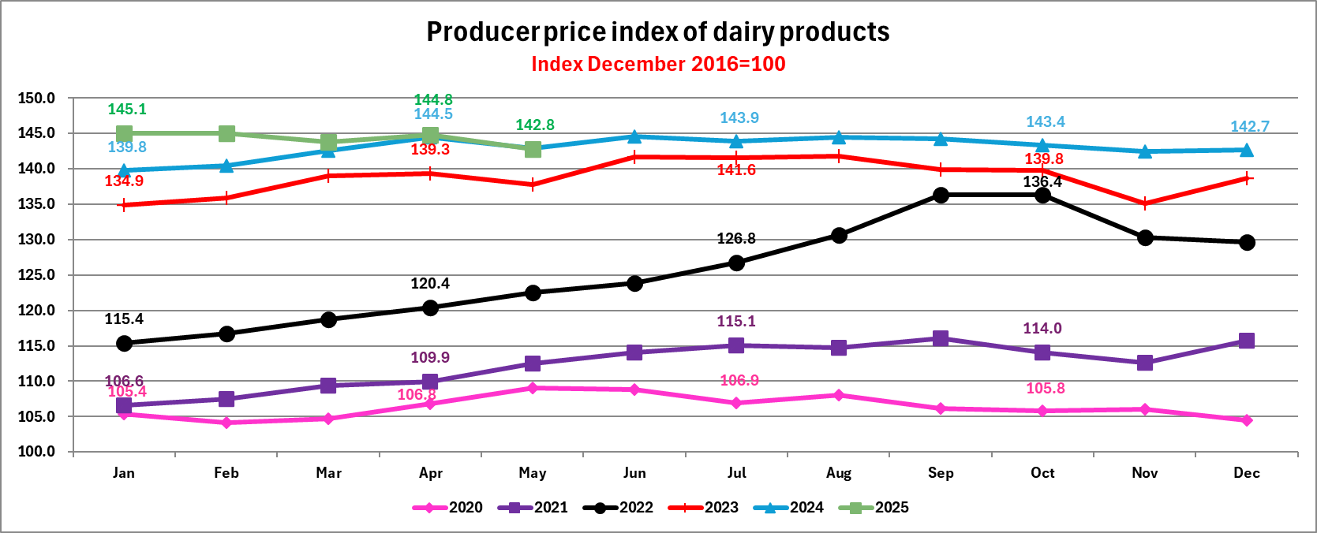
Graph 14
The producer price index of dairy products reflects the changes of the producer prices of pasteurised and UHT milk, yoghurt, cheddar cheese and ice cream and not that
of the other dairy products like maas, cheese other than cheddar cheese and milk powder.
Graph prepared by the Office of SAMPRO based on information published by Statistics SA

Slide 53
Table 27
THE DIFFERENCES BETWEEN THE HIGHEST AND LOWEST PRODUCER PRICE INDEX OF DAIRY PRODUCTS IN SOUTH AFRICA, IN EACH OF THE YEARS 2015 TO 2024
Index: Dec 2016=100
Year | Percent difference
2015 (Highest in May, Lowest in January) | 4.0
2016 (Highest in September, Lowest in January) | 14.0
2017 (Highest in December, Lowest in March) | 3.0
2018 (Highest in May, Lowest in October) | 3.9
2019 (Highest in September, Lowest in April) | 3.3
2020 (Highest in May, Lowest in February) | 4.8
2021 (Highest in September, Lowest in January) | 8.9
2022 (Highest in October, Lowest in January) | 18.2
2023 (Highest in August, Lowest in January) | 5.1
2024 (Highest in June, Lowest in January) | 3.4
Average | 6.9
Table prepared by the Office of SAMPRO based on information published by SARS

Slide 54
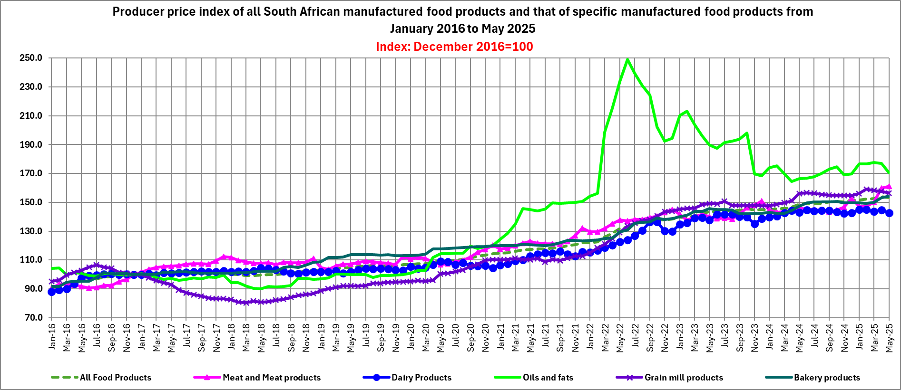
Graph 15
Graph prepared by the Office of SAMPRO based on information published by Statistics SA

Slide 55
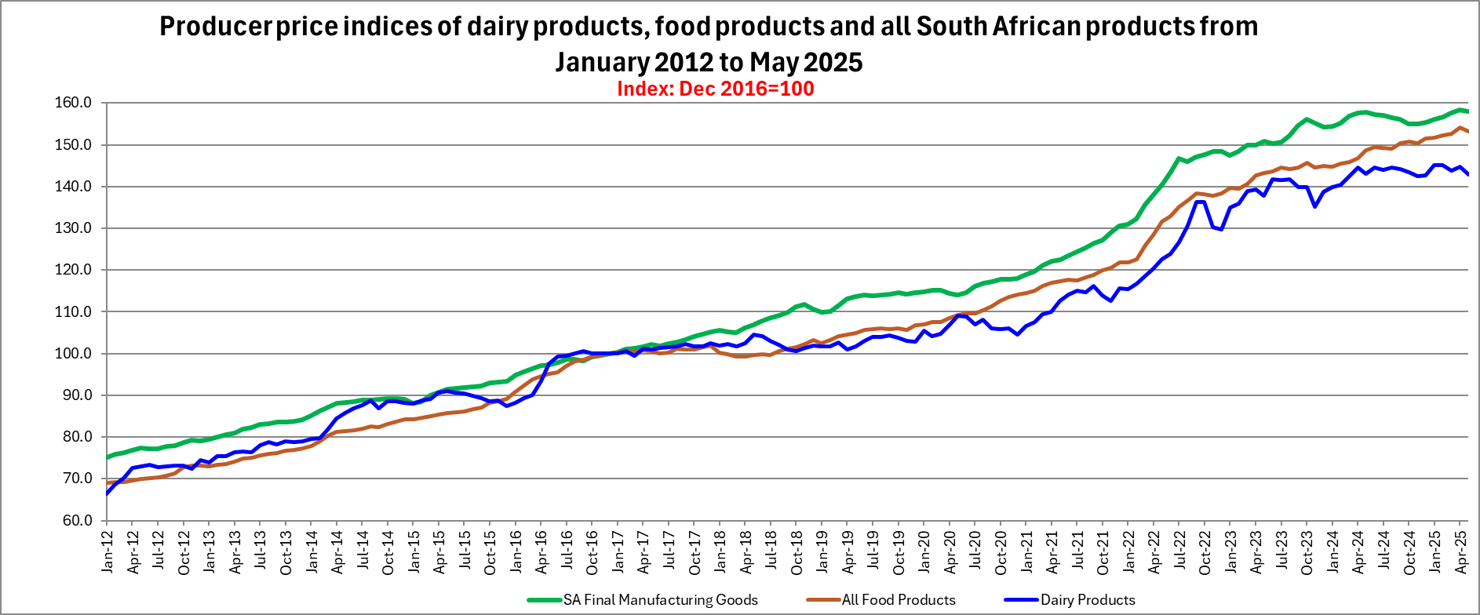
Graph 16
Graph prepared by the Office of SAMPRO based on information published by Statistics SA

Slide 56
Table 28
INCREASE IN PRODUCER PRICE INDICES OF PARTICULAR CATEGORIES OF PRODUCTS WHICH INCLUDE INPUTS OF THE DAIRY INDUSTRY, IN THE YEARS WHICH ENDED IN APRIL 2025
Table prepared by the Office of SAMPRO based on information published by Statistics SA

Slide 57
Table 29
CHANGES IN RETAIL SALES QUANTITIES FROM THE YEAR APRIL 2023 TO MARCH 2024, TO THE YEAR APRIL 2024 TO MARCH 2025; AND CHANGES IN THE RETAIL PRICES FROM MARCH 2024 TO MARCH 2025
PRODUCT | CHANGE IN RETAIL SALES QUANTITIES PERCENT | CHANGE IN RETAIL PRICES PERCENT
FRESH MILK | -0.8 | -0.9
LONG LIFE MILK (UHT MILK) | 6.9 | -0.3
FLAVOURED MILK | 1.7 | 5.6
YOGHURT | 3.8 | 4.2
MAAS | 8.0 | 1.1
PRE-PACKAGED CHEESE | 4.1 | 2.0
CREAM CHEESE | 0.4 | 3.2
BUTTER | -1.7 | -1.4
CREAM | 3.9 | 1.5
Table prepared by the Office of SAMPRO based on the results of surveys by “NielsenIQ”. Non-retail sales such as sales to industrial buyers are not part of the surveys

Slide 58
Table 30
CHANGES IN THE QUANTITIES OF RETAIL SALES OF SPECIFIC DAIRY PRODUCTS IN SOUTH AFRICA
PRODUCT | Sales in the month of March 2025 versus the sales in the month of March 2024 | Sales in the 3 months from January 2025 to March 2025 versus the sales in the 3 months from January 2024 to March 2024 | Sales in the 6 months from October 2024 to March 2025 versus the sales in the 6 months from October 2023 to March 2024 | Sales in the 9 months from July 2024 to March 2025 versus the sales in the 9 months from July 2023 to March 2024 | Sales in the 12 months from April 2024 to March 2025 versus the sales in the 12 months from April 2023 to March 2024
 | percent | percent | percent | percent | percent
Fresh Milk | 1.2 | 0.3 | -0.5 | -0.7 | -0.8
UHT milk | 10.3 | 6.7 | 6.6 | 6.3 | 6.9
Flavoured milk | 1.8 | 0.8 | -0.2 | -0.1 | 1.7
Yoghurt | 5.0 | 3.1 | 3.7 | 3.6 | 3.8
Maas | 6.1 | 7.6 | 7.9 | 7.1 | 8.0
Pre-packaged cheese | 5.6 | 3.6 | 4.2 | 4.7 | 4.1
Cream cheese | 10.9 | 3.5 | 1.3 | 0.7 | 0.4
Butter | -13.6 | -17.4 | -9.5 | -3.6 | -1.7
Cream | 5.6 | 8.3 | 5.9 | 5.1 | 3.9
Table prepared by the Office of SAMPRO based on the results of surveys by “NielsenIQ”. Non-retail sales such as sales to industrial buyers are not part of the surveys

Slide 59
Table 31
THE AVERAGE RETAIL PRICES OF SPECIFIC DAIRY PRODUCTS IN MARCH 2025, COMPARED TO THE AVERAGE RETAIL PRICES OF THE PRODUCTS CONCERNED IN SPECIFIC PREVIOUS MONTHS OF 2024 AND 2023
PRODUCT | March 2025 versus February 2025 (1 month ago) | March 2025 versus December 2024 (3 months ago) | March 2025 versus September 2024 (6 months ago) | March 2025 versus June 2024 (9 months ago) | March 2025 versus March 2024 (12 months ago) | March 2025 versus September 2023 (18 months ago) | March 2025 versus March 2023 (24 months ago)
 | Percent | Percent | Percent | Percent | Percent | Percent | Percent
FRESH MILK | -1.1 | -1.1 | -1.1 | -1.8 | -0.9 | 0.3 | 0.8
UHT MILK | -1.7 | 0.8 | -2.1 | -1.7 | -0.3 | -2.2 | 3.0
FLAVOURED MILK | -2.8 | 4.2 | 1.0 | 5.4 | 5.6 | 5.3 | 6.9
YOGHURT | -2.3 | 2.8 | 0.4 | 2.3 | 4.2 | 6.5 | 9.0
MAAS | -1.0 | 1.0 | -0.6 | -0.3 | 1.1 | 2.0 | 4.4
PRE-PACKAGED CHEESE | -0.04 | 1.7 | 3.5 | 3.3 | 2.0 | 5.9 | 11.4
CREAM CHEESE | 0.1 | -5.9 | -0.3 | -0.8 | 3.2 | -0.3 | 3.3
BUTTER | -4.7 | -0.7 | -4.9 | -4.0 | -1.4 | -4.0 | 2.1
CREAM | -0.5 | -0.04 | 0.02 | 0.3 | 1.5 | 3.9 | 5.5
Table prepared by the Office of SAMPRO based on the results of surveys by “NielsenIQ”. Non-retail sales such as sales to industrial buyers are not part of the surveys

Slide 60
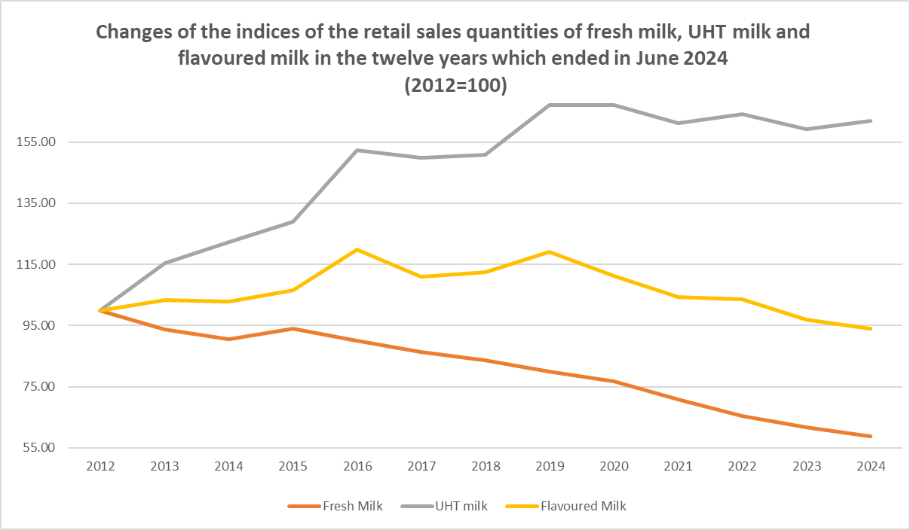
Graph 18
Graph prepared by the Office of SAMPRO based on information obtained from NielsenIQ

Slide 61
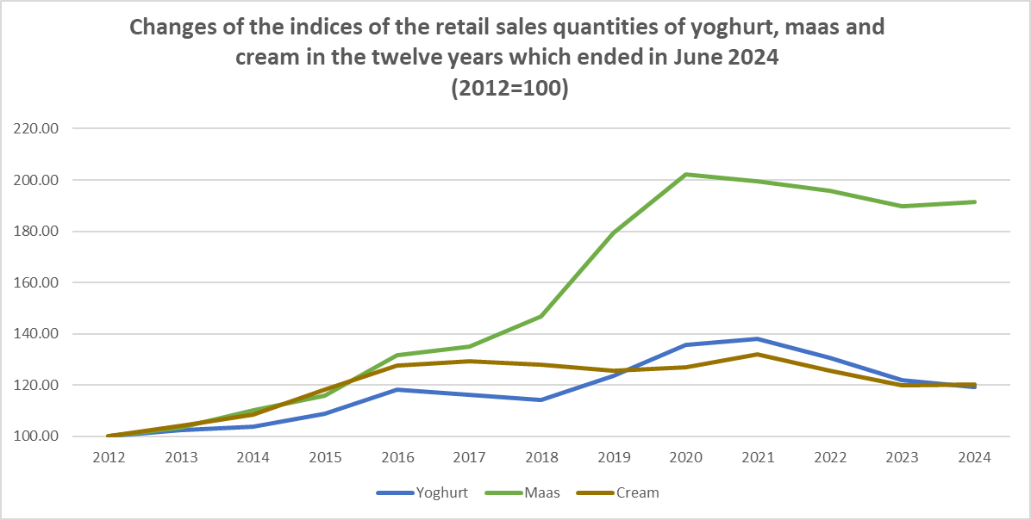
Graph 19
Graph prepared by the Office of SAMPRO based on information obtained from NielsenIQ

Slide 62
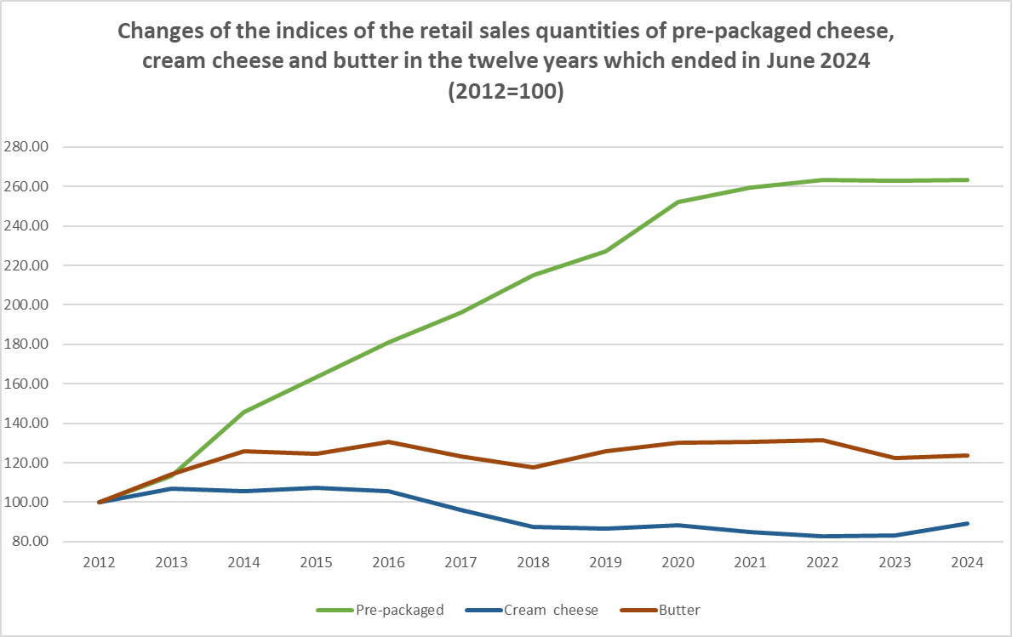
Graph 20
Graph prepared by the Office of SAMPRO based on information obtained from NielsenIQ

Slide 63
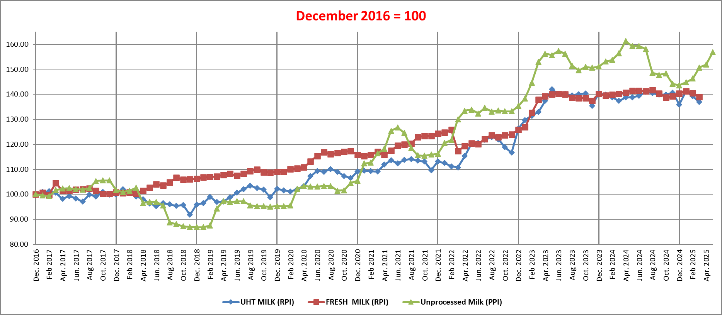
Graph 21
THE PRODUCER PRICE INDEX (PPI) OF UNPROCESSED MILK, FROM DECEMBER 2016 TO MAY 2025 AND THE RETAIL PRICE INDICES (RPI) OF FRESH MILK AND UHT MILK, FROM DECEMBER 2016 TO MARCH 2025
Table 32
INCREASE IN UNPROCESSED MILK PURCHASES RELATIVE TO PREVIOUS YEAR (PERCENT)
2012 | 2013 | 2014 | 2015 | 2016 | 2017 | 2018 | 2019 | 2020 | 2021 | 2022 | 2023 | 2024
4.5 | 2.22 | 2.65 | 6.37 | -0.45 | 3.02 | 4.82 | 0.65 | -0.16 | -0.71 | -1.56 | -0.32 | 3.56
Graph prepared by the Office of SAMPRO based on information obtained from “NielsenIQ” and Statistics South Africa.
Table prepared by the Office of SAMPRO based on information obtained from Milk SA.

Slide 64
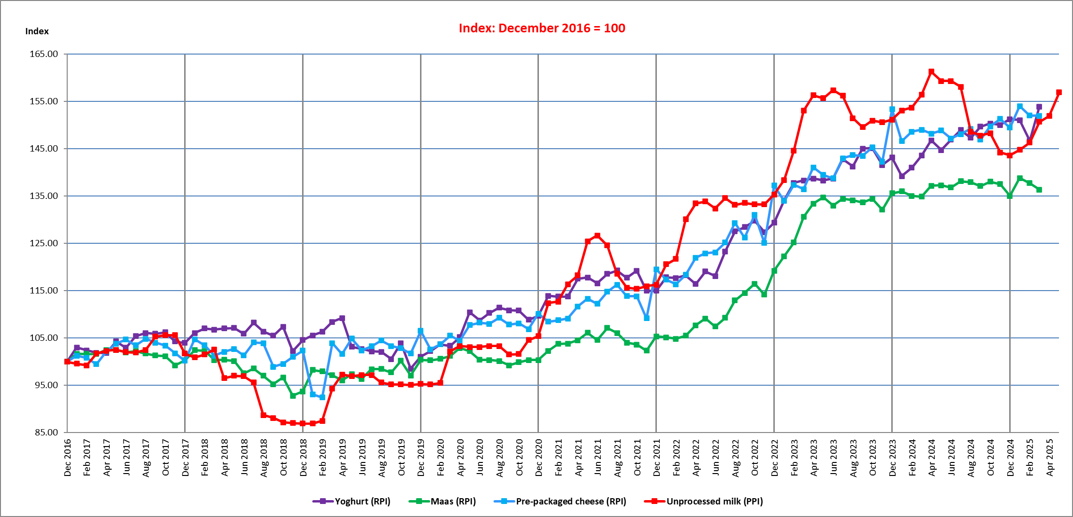
Graph 22
THE PRODUCER PRICE INDEX (PPI) OF UNPROCESSED MILK, FROM DECEMBER 2016 TO MAY 2025 AND THE RETAIL PRICE INDICES (RPI) OF YOGHURT, MAAS AND PRE-PACKAGED CHEESE, FROM DECEMBER 2016 TO MARCH 2025
Table 33
INCREASE IN UNPROCESSED MILK PURCHASES RELATIVE TO PREVIOUS YEAR (PERCENT)
2012 | 2013 | 2014 | 2015 | 2016 | 2017 | 2018 | 2019 | 2020 | 2021 | 2022 | 2023 | 2024
4.5 | 2.22 | 2.65 | 6.37 | -0.45 | 3.02 | 4.82 | 0.65 | -0.16 | -0.71 | -1.56 | -0.32 | 3.56
Graph prepared by the Office of SAMPRO based on information obtained from “NielsenIQ” and Statistics South Africa.
Table prepared by the Office of SAMPRO based on information obtained from Milk SA.

Slide 65
Table 34
THE HIGHEST AND LOWEST DIFFERENCES RECORDED BETWEEN THE AVERAGE MONTHLY RETAIL PRICES OF UHT MILK AND FRESH MILK AND THE DIFFERENCES BETWEEN THE AVERAGE ANNUAL RETAIL PRICES OF UHT MILK AND FRESH MILK, IN THE YEARS 2012 TO 2024
YEAR | Percentage difference ⁴⁰⁾
 | Highest monthly | Lowest monthly | Average annual
2012 | 17.1 | 0.7 | 8.9
2013 | 8.9 | 2.8 | 5.9
2014 | 12.5 | 5.8 | 9.2
2015 | 11.9 | -0.7 | 5.6
2016 | 6.9 | 0.7 | 3.8
2017 | 1.8 | -2.6 | -0.4
2018 | 0.0 | -7.9 | -4.0
2019 | 3.8 | -3.8 | 0.0
2020 | 4.3 | 0.4 | 2.3
2021 | -3.8 | -2.4 | -3.1
2022 | -0.4 | -3.3 | -1.9
2023 | 2.9 | 3.6 | 3.3
2024 | 0.4 | -1.2 | -0.4
Average | 5.1 | -0.6 | 2.2
The percentages indicated are the percentages which the average retail prices of UHT milk were higher than that of fresh milk.
Table prepared by the Office of SAMPRO based on the results of surveys by “NielsenIQ”. Non-retail sales such as sales to industrial buyers are not part of the surveys.

Slide 66
Summary and Conclusion:
Future growth of demand for consumer goods, including dairy products, is hugely dependent on the level of economic growth in South Africa.
Optimistic expectations about consumer demand in 2025, not supported by:
  Extremely high uncertainty in the world and very high uncertainty in SA;
  In 2024, the GDP increased by 0,53%;
  Expected increase of GDP in 2025:
    Reserve Bank at the beginning of the year predicted a growth rate of 1.7 percent in the GDP in 2025, but in May 2025, it was decreased to 1.2 percent (a reduction of 29.41 percent); and
    The IMF at the beginning of the year predicted a growth rate of 1.5 percent in 2025, but in April 2025, it was decreased to 1.0 percent (a reduction of 33.33 percent).

Slide 67
Retail sales quantities of dairy products in 2023, lower than in 2022.
In 2024, retail sales quantities of 8 of the 9 dairy products were higher than in the previous year.
As foreseen as a realistic possibility, the higher supply of dairy products created amidst very low economic growth, downward pressure on prices. The retail prices of 3 of the 9 dairy products decreased in the year which ended in March 2025, and from February to March 2025, the retail prices of 8 of the 9 dairy products decreased.
In the year which ended in March 2025, the retail sales quantities of 7 of the 9 dairy products increased and in the quarter which ended in March 2025, the retail sales quantities of 8 of the 9 dairy products increased.
In the year which ended in March 2025, the retail sales prices of 6 of the 9 dairy products increased in the quarter which ended in March 2025, the retail sales prices of 5 of the 9 dairy products increased and from February 2025 to March 2025, the retail sales price of only 1 of the 9 dairy products increased.
Higher sales quantities of dairy products, achieved at the expense of price.

Slide 68
Production of unprocessed milk:
  In the last 2 months of 2023, in each month of 2024, and the first 3 months of 2025, higher, but in April 2025 and May 2025, lower.
The relationship between the PPI of unprocessed milk and the index of the combined price of yellow maize and soybeans recently moved to an unfavourable position, but in March and April 2025, it was favourable.
Prevention of the spread of Foot and Mouth Disease is important.
Prices of electricity, water and particular other inputs of primary and secondary dairy industries, higher than inflation.
Most elements of the situation can change fairly quickly and meaningfully, the relevant variables should continuously be monitored, and changes should timeously be reacted to, in order to ensure that in South Africa, the supply of unprocessed milk and dairy products follows the demand for these products as closely as possible.

Slide 69
Alwyn P Kraamwinkel (M.Com)
CEO: SAMPRO
22 July 2025
The following contributions to this presentation are acknowledged:
De Wet Jonker (B.Econ/B.Com Hons), Dr Ndumiso Mazibuko (Bsc Agric Econ, Msc, MBA, PhD) Jan Theron, (B.Com Economy), and Marietjie le Roux (B.Com Human Resources) | Collecting information, compiling of tables and graphs and assessment of information.
Gerhard Venter (M.Sc Agric Food Science) | Dairy Technical advice.
Sonja van Jaarsveldt | Assistance in preparing documents

